Slide 1



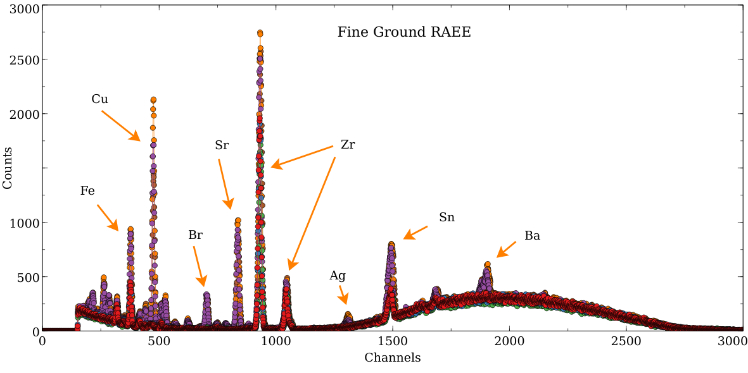
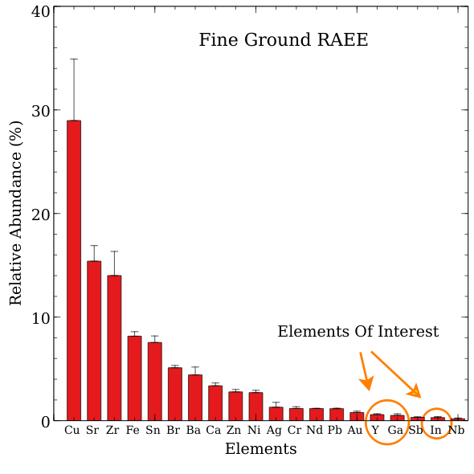
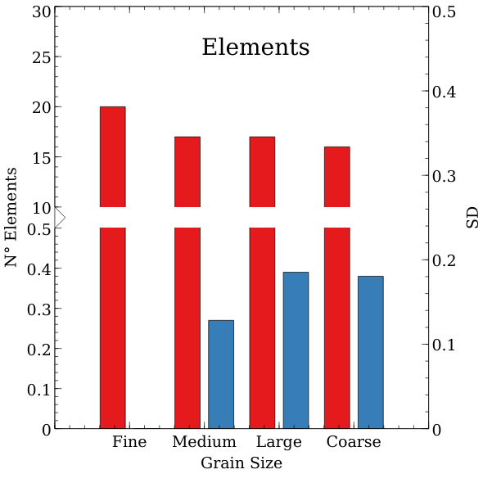
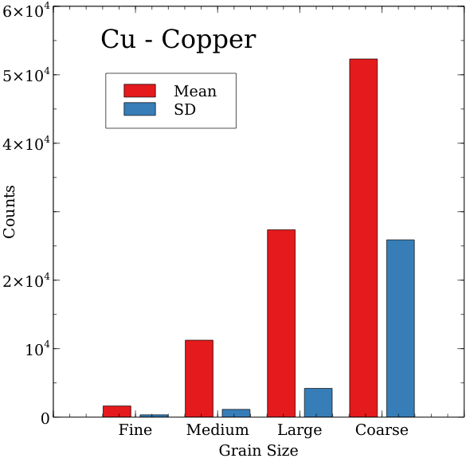
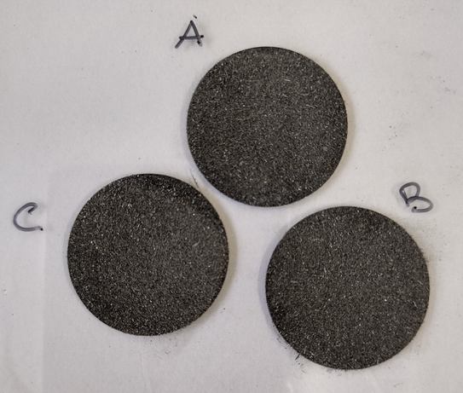
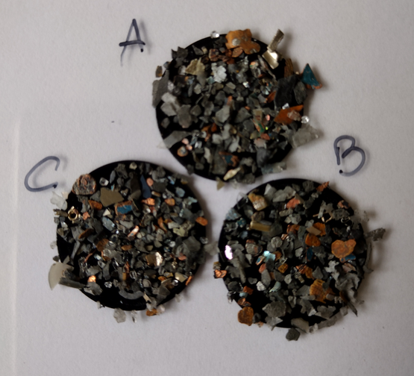
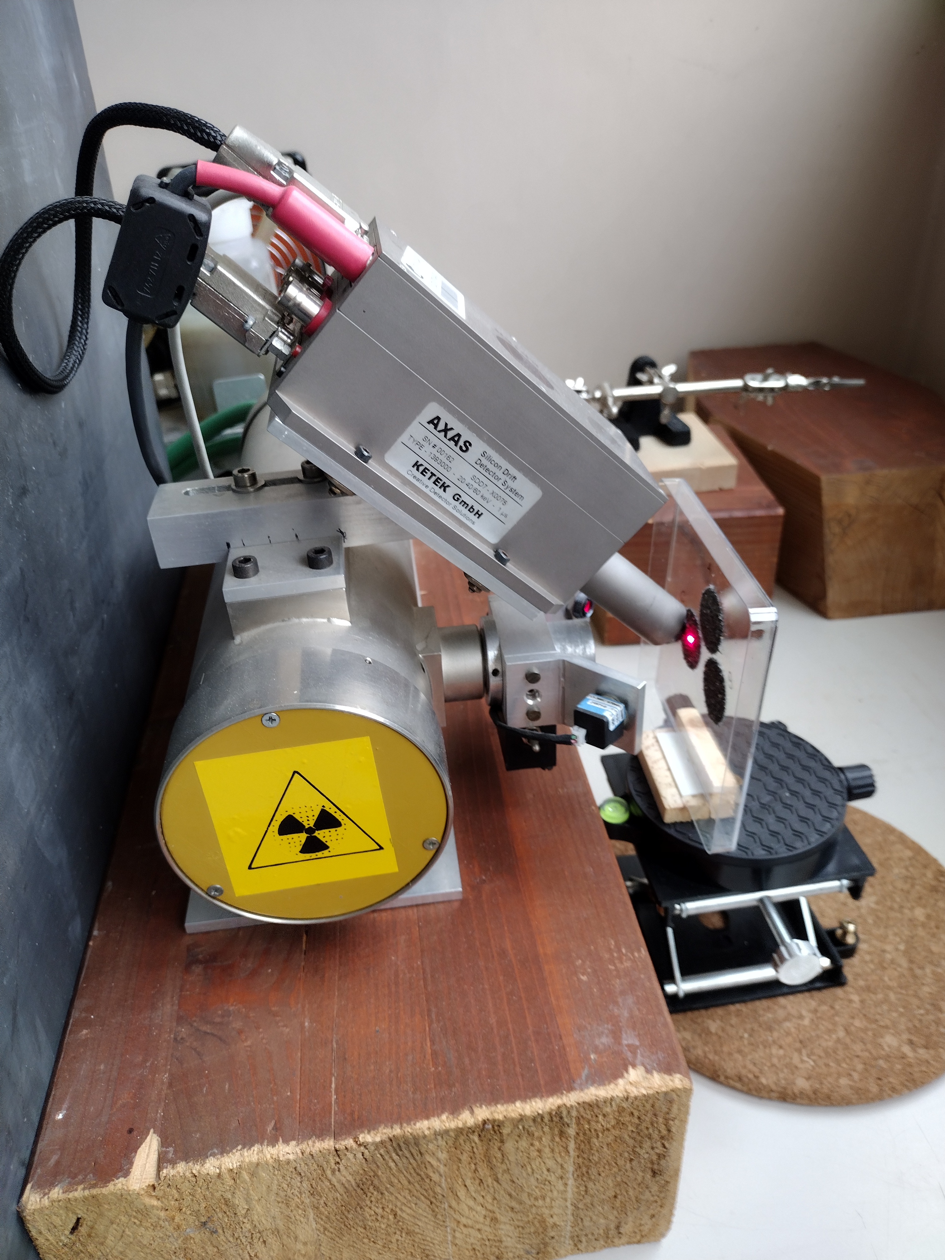
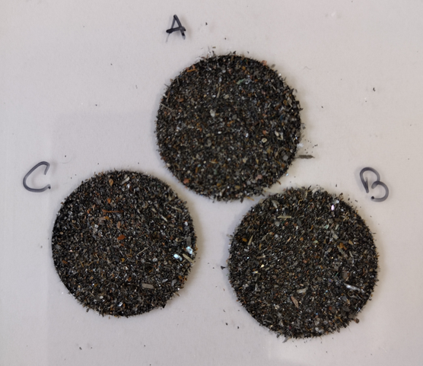
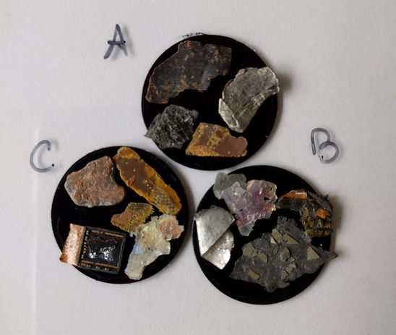

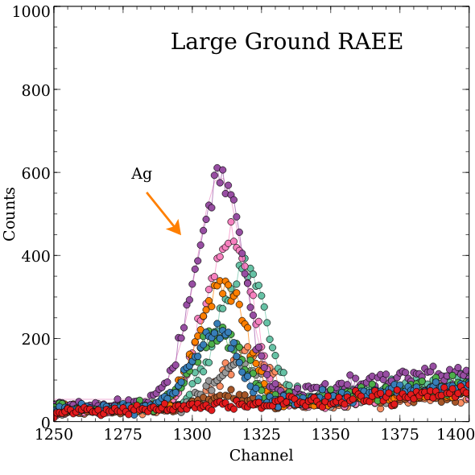
CNR IRET Conference
Rome, February 18th-19th 2025
Qualitative X-ray fluorescence spectroscopy characterization of ground electronic waste
Muzzini V.G.¹, Iori V.², Spinelli V.³, Pinzari F.⁴, Donati E.⁴, Astolfi M.L.⁵, Persiani A.M.³, Mazzonna M.⁴, Ceci A.³
1 Research Institute on Terrestrial Ecosystems-National Research Council (CNR-IRET), 2 Institute of Agricultural Biology and Biotechnology-National Research Council (CNR-IBBA), 3 Department of Environmental Biology, Sapienza University of Rome, 4 Institute for Biological Systems-National Research Council (CNR-ISB), 5 Department of Chemistry, Sapienza University of Rome
Introduction and Aims
Results & Conclusions
Efficient recovery of critical strategic elements from electronic waste (e-waste) is crucial to meeting rising global demand. In this context, fungi offer a promising, nature-based approach to recovering target elements from e-waste. Effective recovery strategies, however, depend on characterizing the elemental composition of the ground e-waste. The XRF technique works by exciting a sample with high-energy X-rays, resulting in the emission of characteristic secondary X-rays from the material, which display peaks corresponding to different elements and their respective concentrations. In this study, XRF technique was employed to identify the elemental composition of ground e-waste samples fractionated by particle size.
The results indicated an abundance of Cu, Sr, Zr, Fe, Sn, Br, Ba, Zn, and Ni. In addition, the analysis of the finest-grained sample revealed trace amounts of Ga, Y, and In, elements of particular interest.
As expected, larger particle size reduces the ability to identify Elements, increasing variability between samples. Furthermore, while signal intensity (counts) of the identified elements increases (Mean, Cu-Copper), so does the variability of the mean value (SD, Cu-Copper) across all samples of the same granulometric size
Materials and Methods
In this study, multi-metal substrates obtained from ground electronic devices and supplied by B.T.T. Italia S.r.l., a private company specializing in e-waste recycling, were subjected to granulometric separation through sieving (1 - x > 2.80 mm; 2 - 2.80 mm > x > 710 µm; 3 - 710 µm > x > 125 µm; 4 - x < 125 µm). Each fraction was then characterized by XRF spectroscopy, using Leit adhesive carbon tabs of 25 mm diameter, to assess composition and element enrichment across the fractions. The X-ray source operated at 60 kV and 0.4 mA with a beam
1
3
Acknowledgements
PRIN 2022 PNRR Project funded by European Union –NextGeneration EU, Mission 4, Component C2 - CUP B53D23032140001- Project Prot. P2022ENEWL - Title “Fungal interaction with metals (FUN METALS): transformation and mechanisms for biorecovery”. We also thank B.T.T. Italia S.r.l. for the provided material.
The varying intensity and signal variability of samples with Large granulometry are exemplified by the silver peak.
The XRF technique combined with the EDXRF detector has proven to be highly effective, allowing rapid and simultaneous identification of elements within the sample. Granulometric analysis indicated that the fine fraction is optimal for identifying elements in the ground sample. Conversely, larger particle sizes, despite offering a higher signal-to-noise ratio, introduced greater variability into the measurements.
2
4
X-Ray source
diameter of just over 10 mm on the sample. An energy-dispersive X-ray fluorescence (EDXRF) detector was positioned to directly capture the energies of the X-rays emitted by the sample. The acquisition time was set to 300 s to improve the signal-to-noise ratio.
Valerio G. Muzzini

