Slide 1



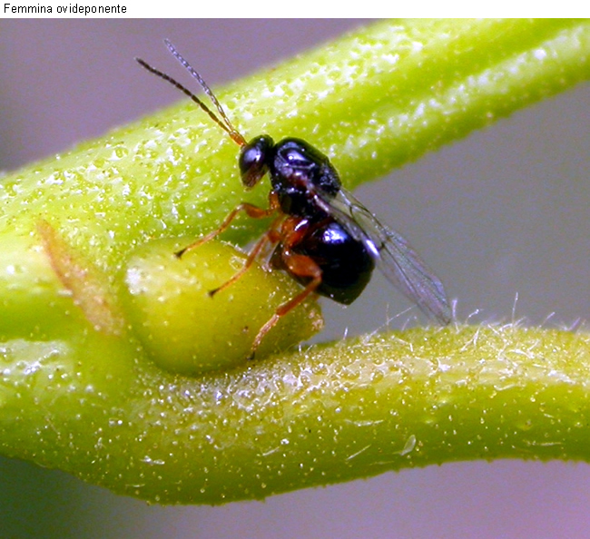
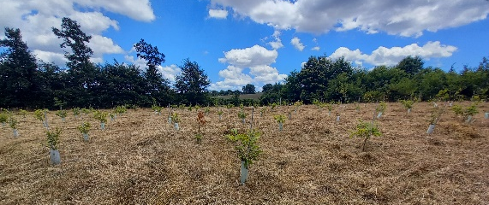
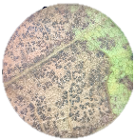
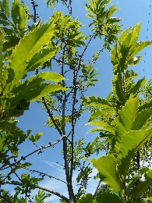
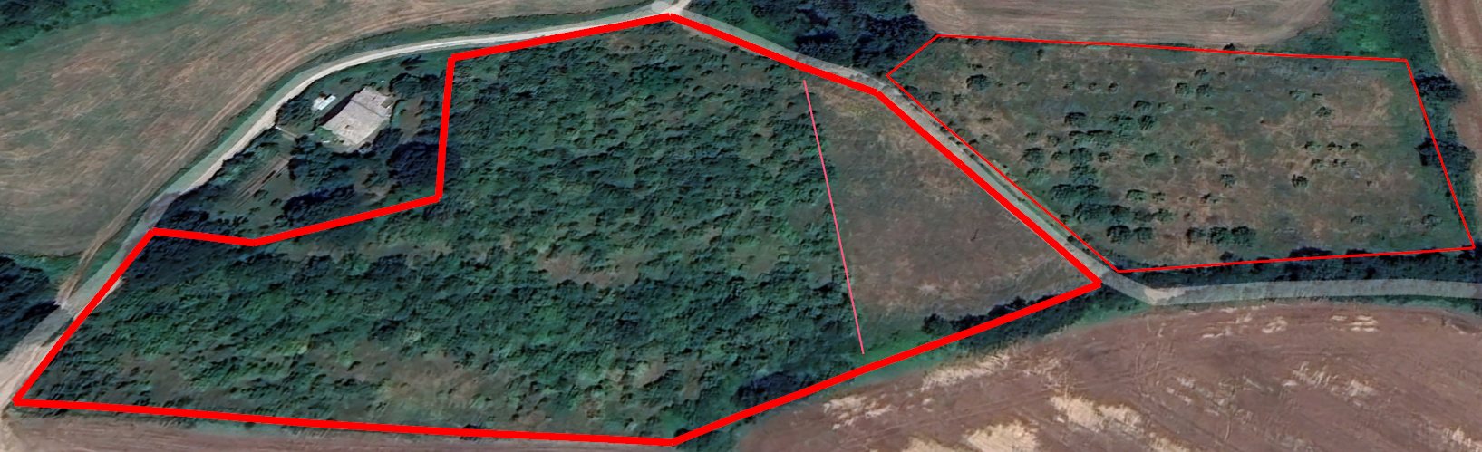
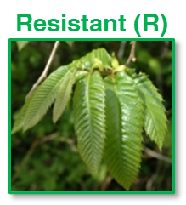
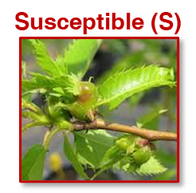
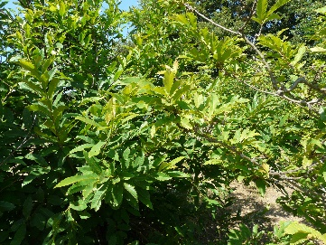
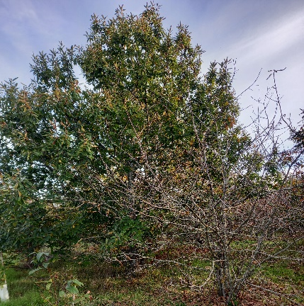
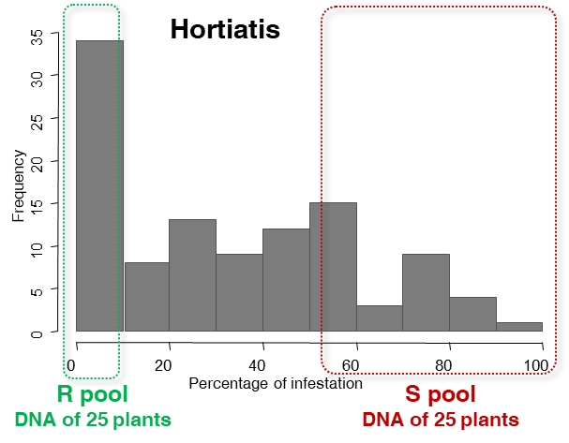
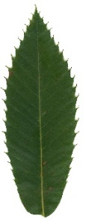
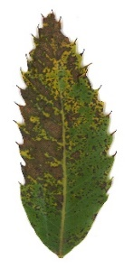
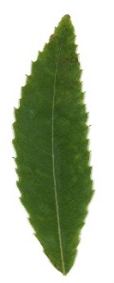
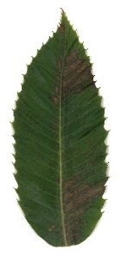
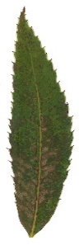
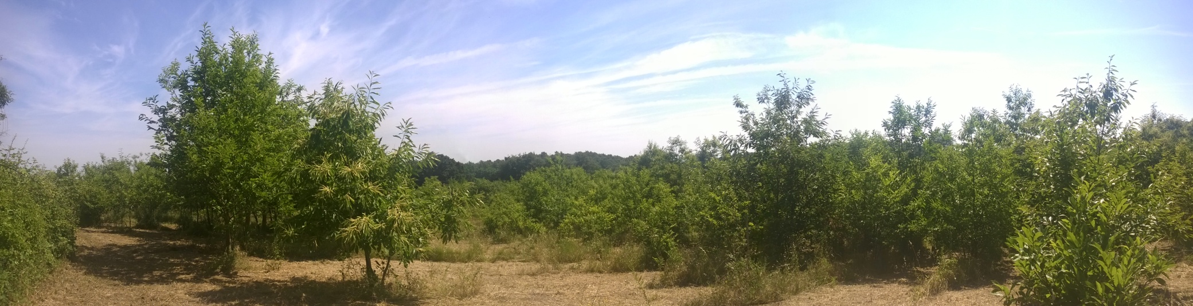
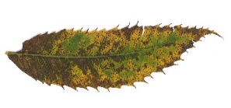
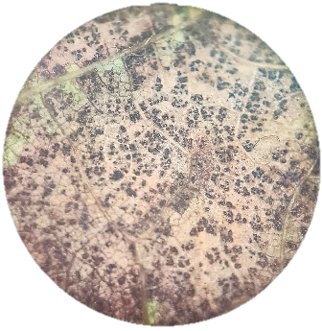
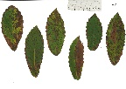
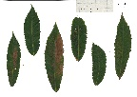
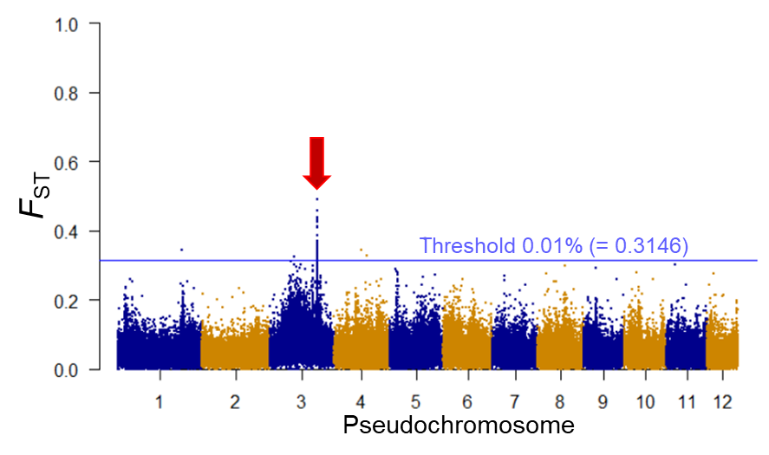

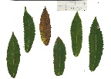
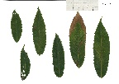
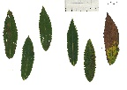
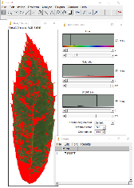




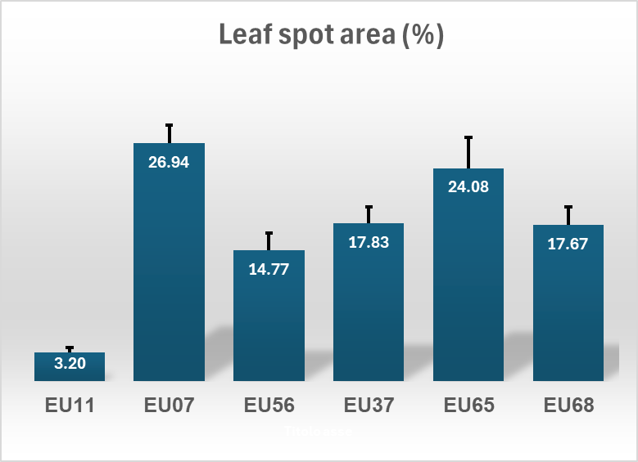









CNR IRET Conference
Rome, February 18th-19th 2025
Ex-situ collections of Castanea sativa provenances as genetic sources of resistance to abiotic and biotic stress
Resistance to Asian Chestnut Gall Wasp
Castanea sativa ex-situ common garden field CNR IRET
Resistance to leaf spot disease (Fersa)
Castanea sativa
Provenance Hortiatis (Greece)
High number of plants resistant
Fersa: Parasitic fungi, Mycosphaerella maculiformis, that cause leaf spot. Emerging diseases of European chestnut.
Provenance field trial
Plantation in 2002
EU Project CASCADE)
Today ≈ 1000 plants
Cross of contrasting genotypes from Bursa and Hopa (Turkey)
Bursa X Hopa (1998)
Differences in extent of leaf spot necrosis was observed among provenances.
6 provenances:
Spain,
Italy,
Greece
Half-sib families from Bursa, Hopa and Golcuk (Turkey), 2-year-old trees planted in 2022
Full-sib F1 familly
2 contrasting sites per country (mesic vs xeric)
Typical spots on chestnut leaves
Experimental design to test differences between provenances:
10 random plants / provenance = 60 plants
12 leaves / plant = 720 leaves.
Microscope enlargement of spots
DNA Pool sequencing (Pool-GWAS)
Alignment with C. mollissima reference genome
Pool comparison with POPOOLATION2
F_{ST} analysis on 1 kpb windows
Fisher exact test on individual SNPs
Small genomic region on
pseudochromosome 3
Leaves sampled on October 10, 2024 on 2 opposite sides each plant:
3 branches randomly sampled at the top, middle and bottom of the plant.
The 2nd and the 7th leave of the year’s shoot were collected on each branch
21 significant SNPs associated to resistance
Leaf digital images analysed with Image J to determine the ratio of infected leaf area.
Kruskal-Wallis test and Wilcoxon Post-hoc test for multiple comparison
Pseudochromosome 3
a
a
Start
Saccharide gene cluster
End
c
b
b
Kruskal-Wallis; Factor Provenance, p < 2.2e-16
Wilcoxon tests; p < 0.05, Benjamini-Hochkberg adjust..
(0 bp)
(69,013,774 bp)
SNPs with –log₁₀(p) > 8.44 (Bonferoni-corrected threshold)
Rac-like GTP-binding protein (RAC2)
UDP-Glycosyltransferase (UGT87A1)
SNPs with 8.44 < –log₁₀(p) < 7.30
Cytochrome P450: CYP71
Uncharacterized
d
Significant variation in leaf spot susceptibility among provenances
Spain provenance EU11 showed a markedly lowest level of leaf spot susceptibility.
Unique genomic region associated to Asian Chestnut Gall Wasp resistance
Identification of a Unique Genomic Region in Sweet Chestnut (Castanea sativa Mill.) That Controls Resistance to Asian Chestnut Gall Wasp Dryocosmus kuriphilus Yasumatsu.
Muriel Gaudet; Paola Pollegioni; Marco Ciolfi; Claudia Mattioni; Marcello Cherubini; Isacco Beritognolo
Plants 2024, Volume 13, Issue 10, 1355
Spain
Italy
Greece
Suitable plant material to study mechanisms of leaf spot resistance at genetic/genomic level
Relevance of experimental fields
Isacco Beritognolo, Marcello Cherubini, Luca Leonardi
Muriel Gaudet

