Slide 1


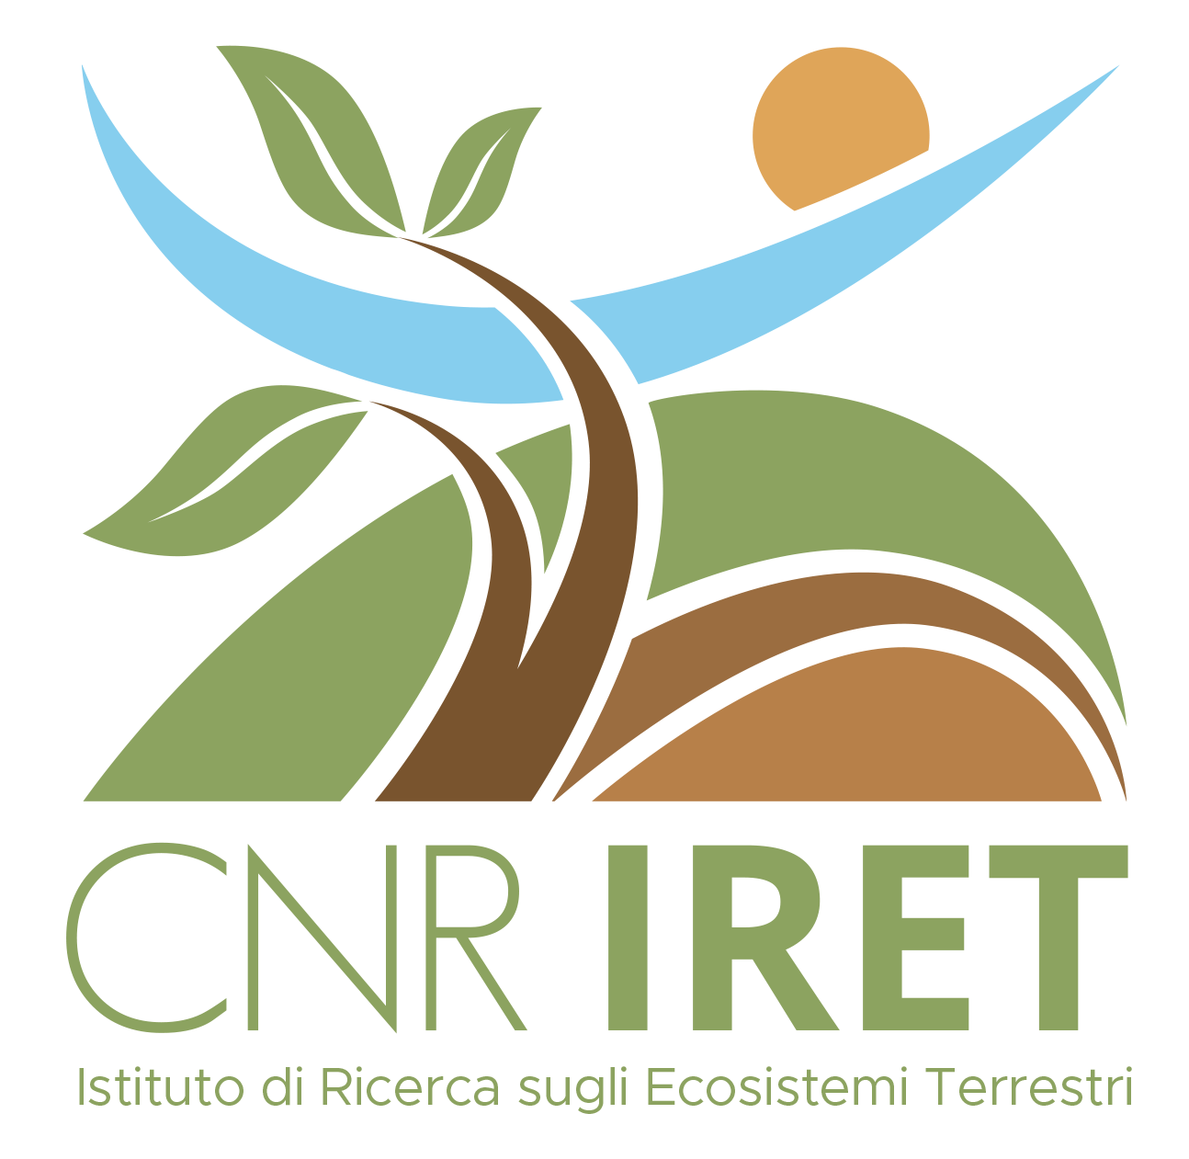



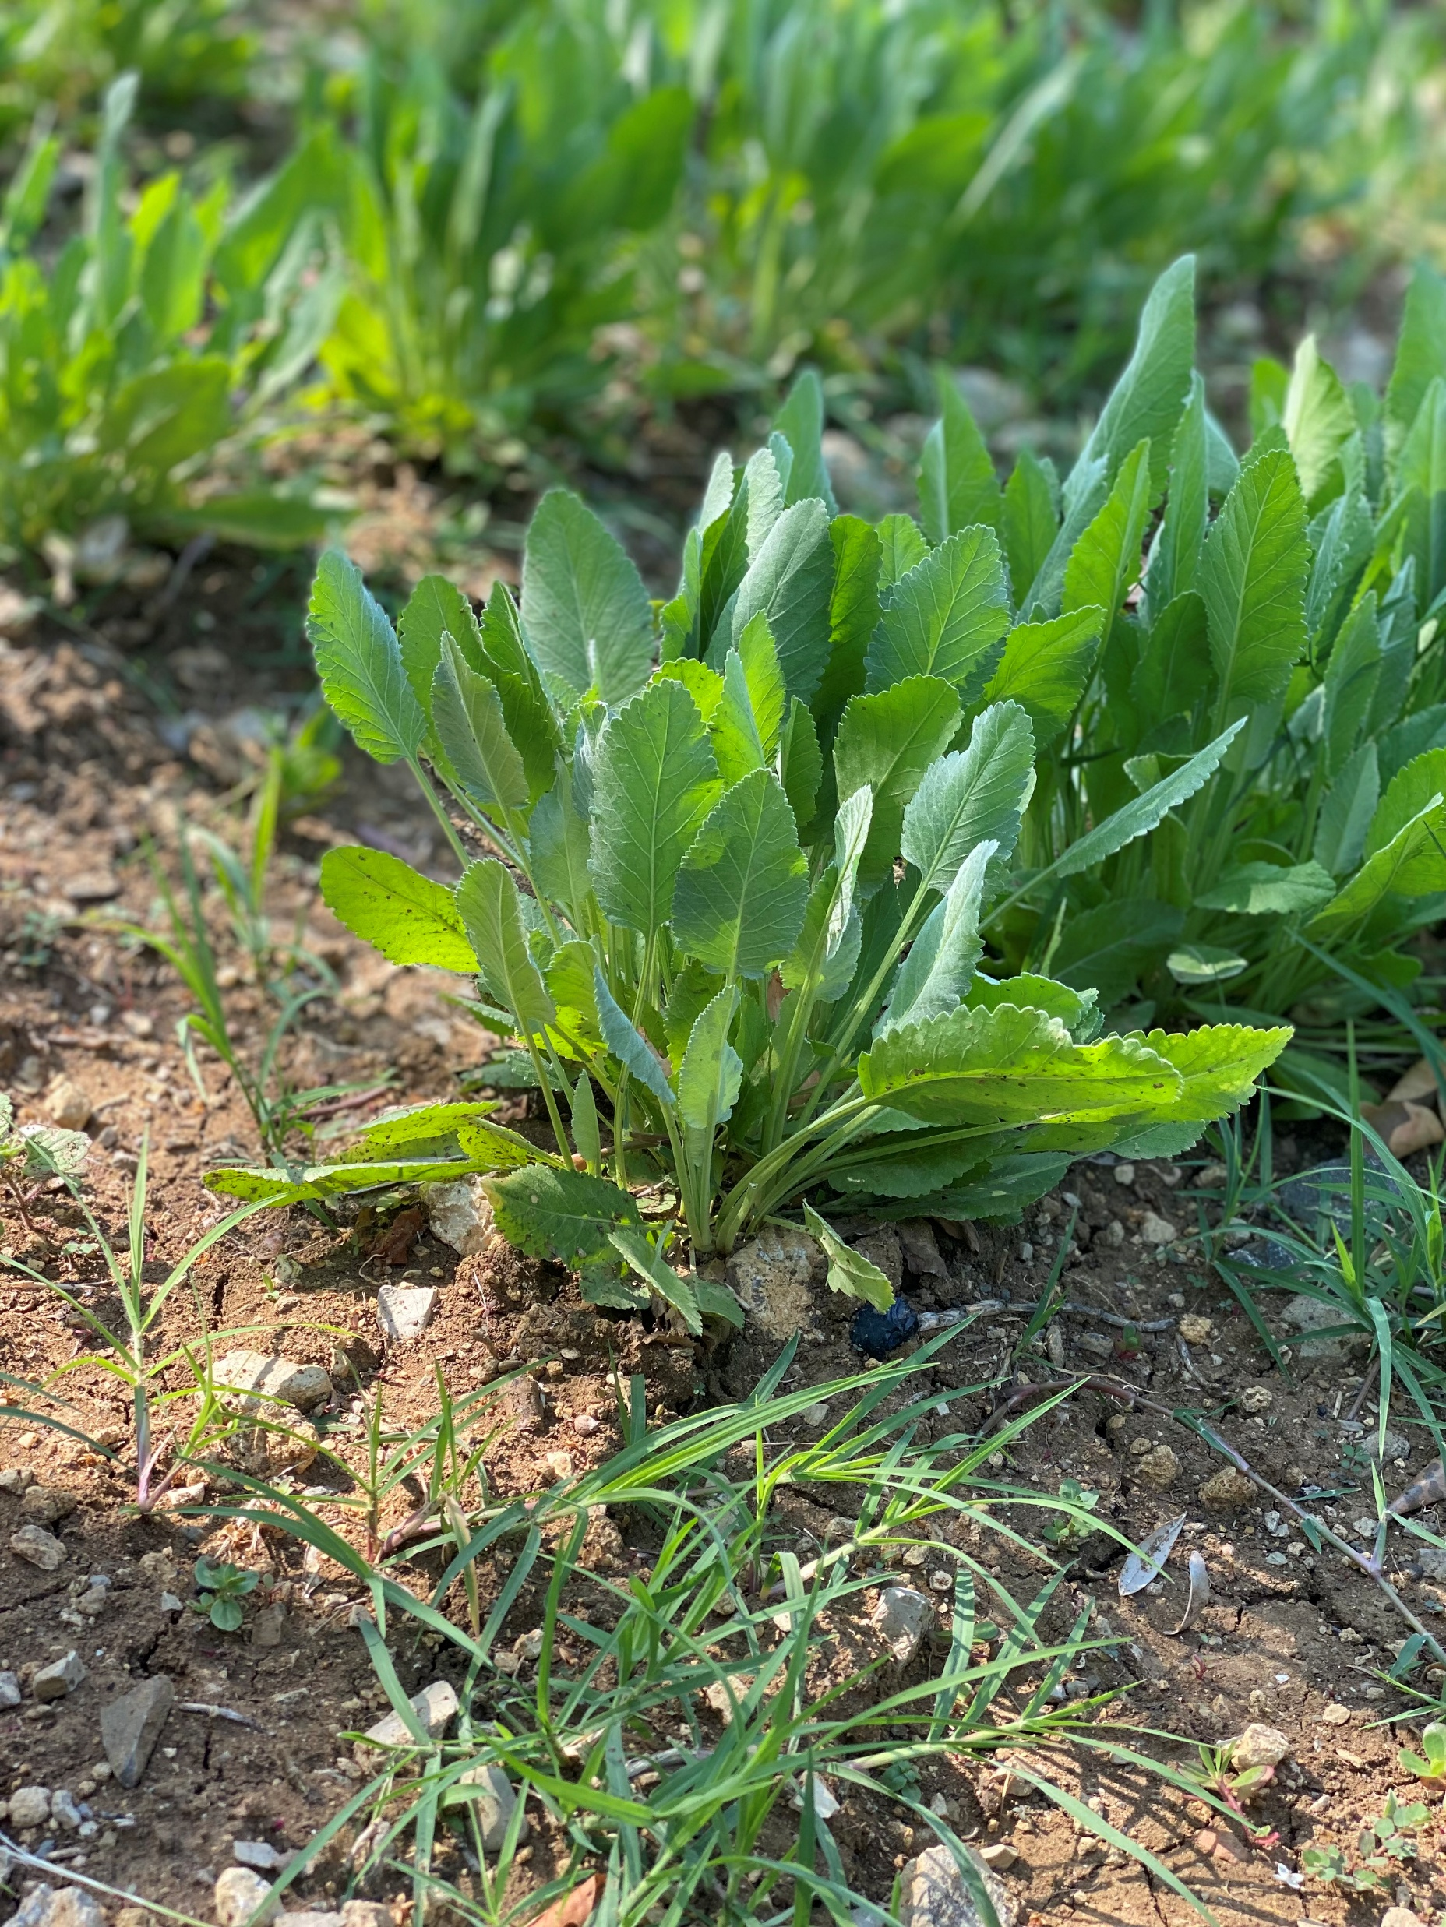



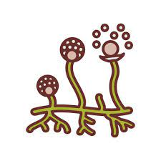




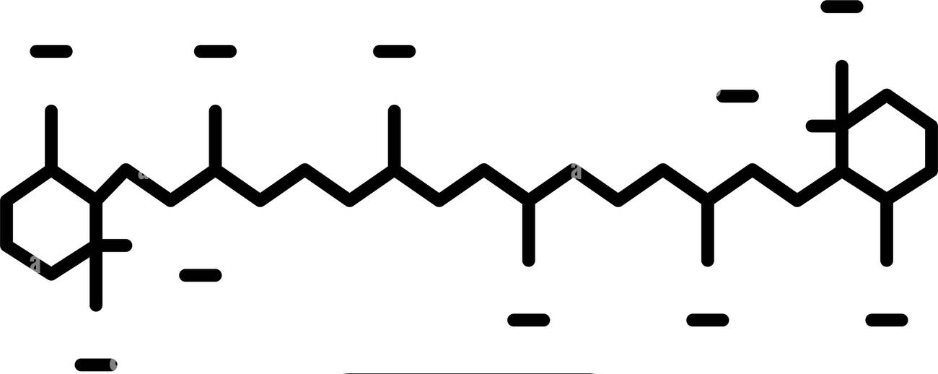



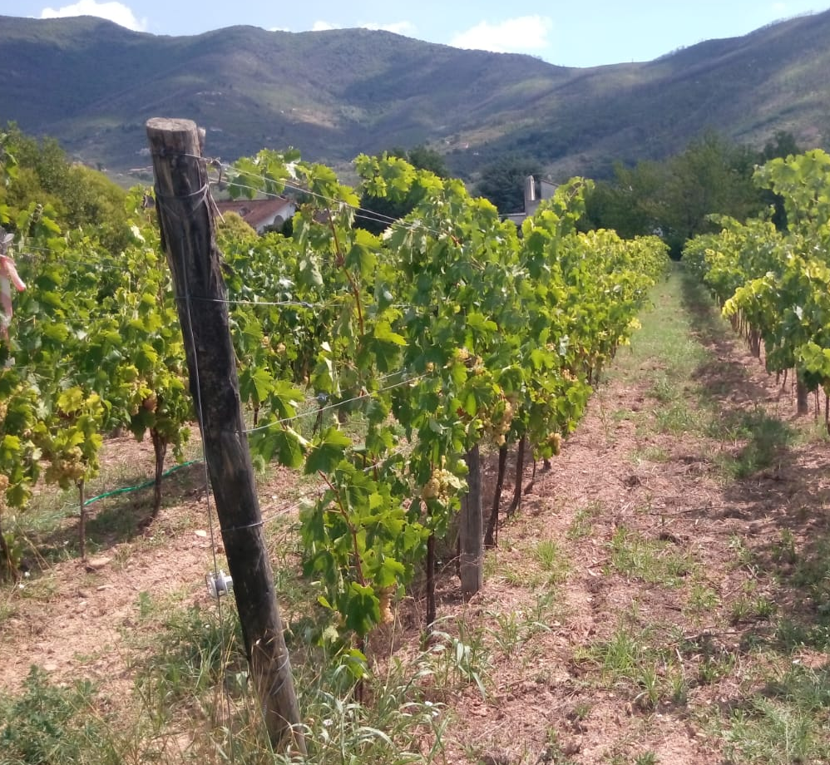



CNR IRET Conference
Rome, February 18th-19th 2025
Improving productivity in Tanacetum balsamita L. and vineyards through sustainable soil cropping management strategies
M. Grattacaso¹, A. Bonetti¹, S. Di Lonardo^{1,3}, E. L. Tassi², F. Bretzel^{2,3}, I. Rosellini², M. Scatena², R. Pini², L. P. D’Acqui^{1,3}
¹Research Institute on Terrestrial Ecosystems (IRET), National Research Council (CNR), Via Madonna del Piano 10, 50019, Sesto Fiorentino, Italy, ² Research Institute on Terrestrial Ecosystems (IRET), National Research Council (CNR), Via Moruzzi 1, Pisa, 56124, Italy, ³ National Biodiversity Future Center (NBFC), Palermo, 90133, Italy.
Introduction
Results and Discussions
Borneol
This study focuses on enhancing soil health and crop resilience in Mediterranean agroecosystems through the combined use of microbial inoculants, biofertilizers, and sustainable farming practices, reducing the dependence on chemical fertilizers and improving soil fertility and water use efficiency.
+
=
+
&
Material and Methods
Tanacetum balsamita L.
Experimental fields of a medicinal plant in Florence and vineyard in Calci (Pisa) were established.
P, Mn, Cu
in
K, Ca, Mg
The experimental design consisted of 12 plots each with 3 replicates. Treatments included:
+
+
=
K
in
Mn
a)
b)
c)
d)
Mg, Fe, Mn
+
Vitis vinifera L.
in
P
PGPR + MF
Compost
Control
Conclusions
Ca
Soil and plants were collected after one year (2023) to compare various treatments and control in terms of the main soil properties and plant performances.
Results show that the inoculum had the greatest impact on Balsamita yield, while the combined treatment mainly influenced grape nutrition. Further studies are underway to clarify the mode of action and identify the most effective treatment for each species.
Martina Grattacaso

