Slide 1


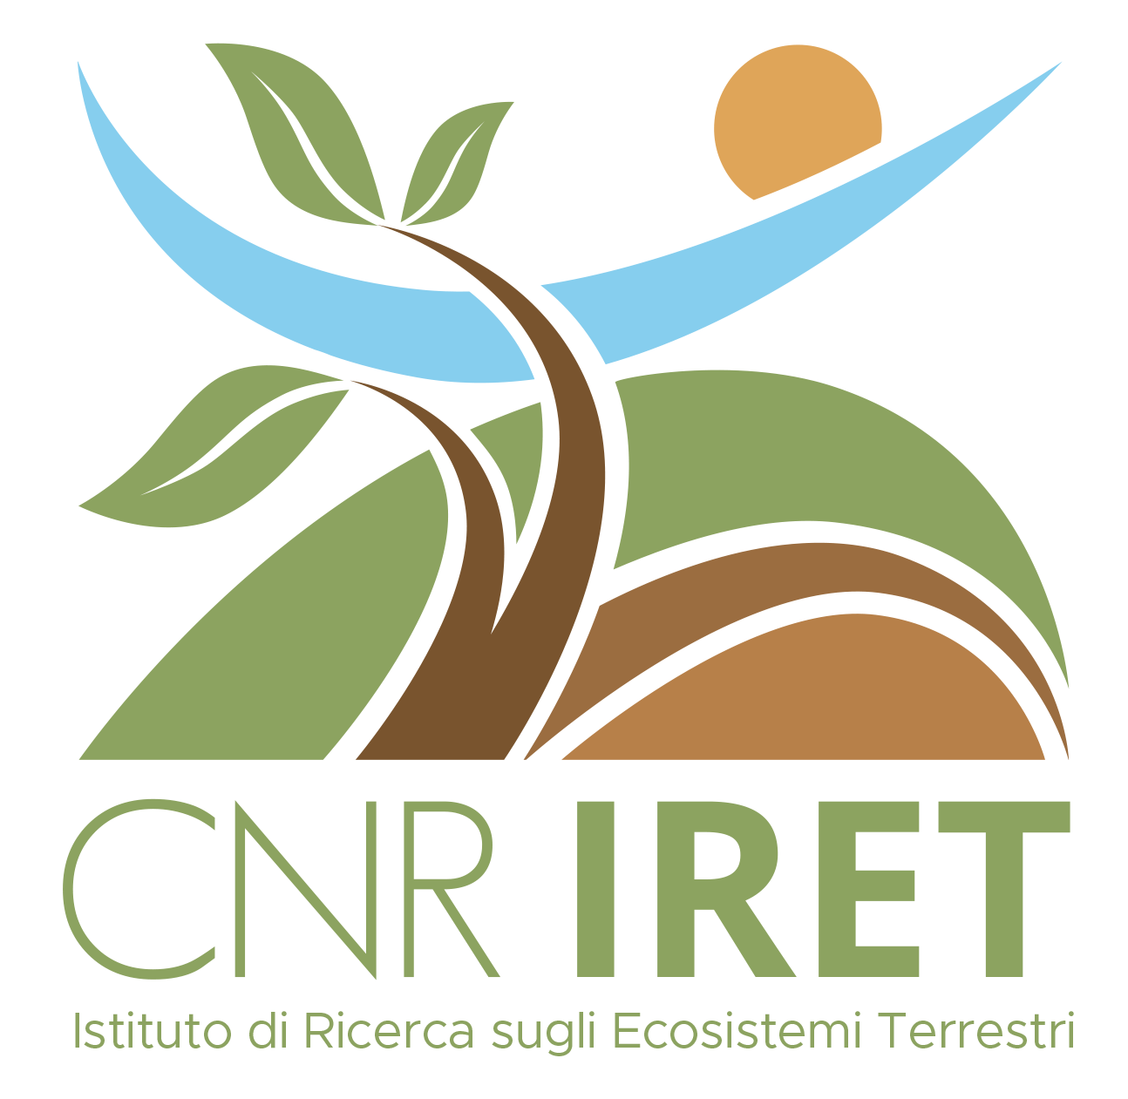
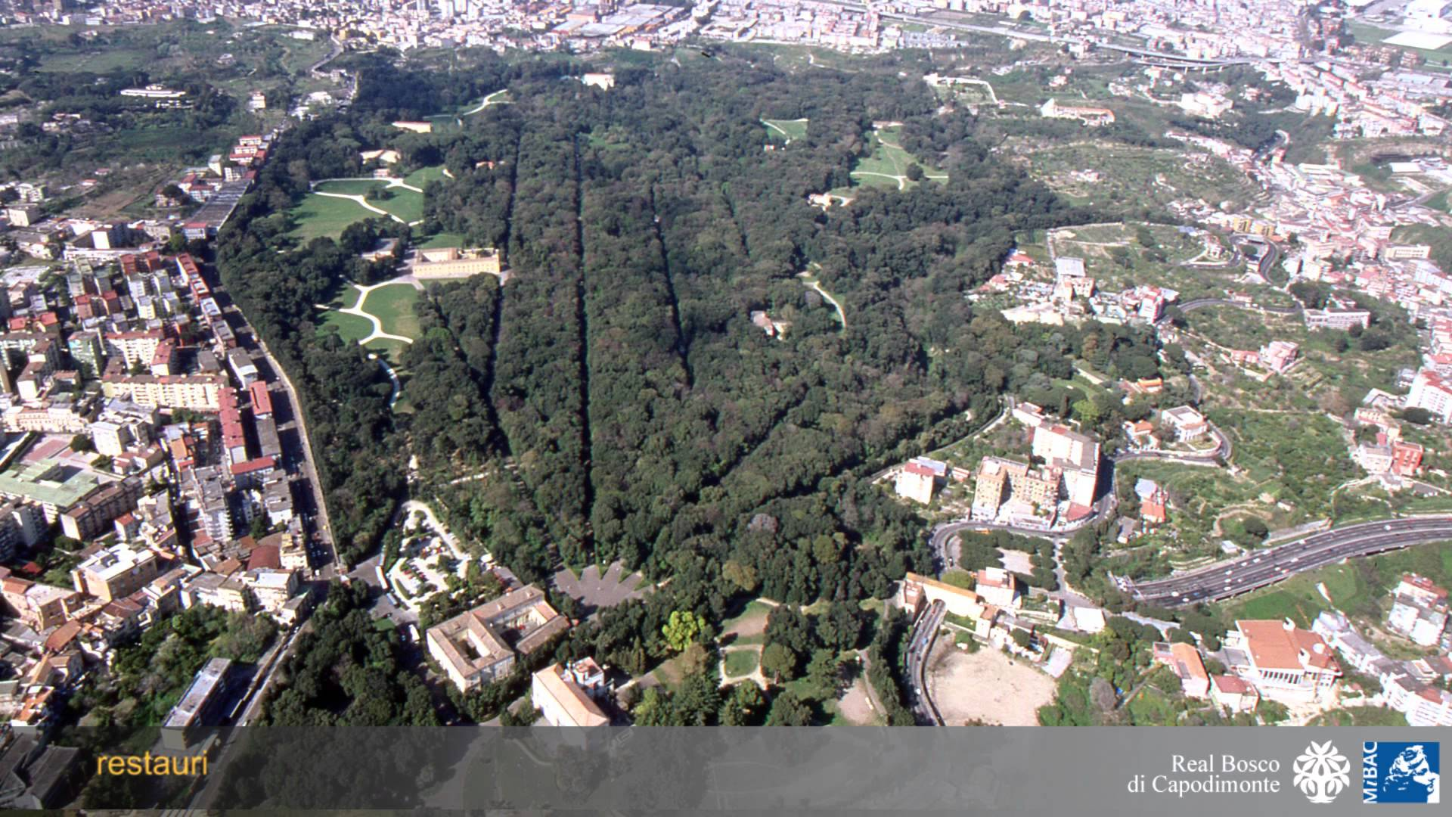
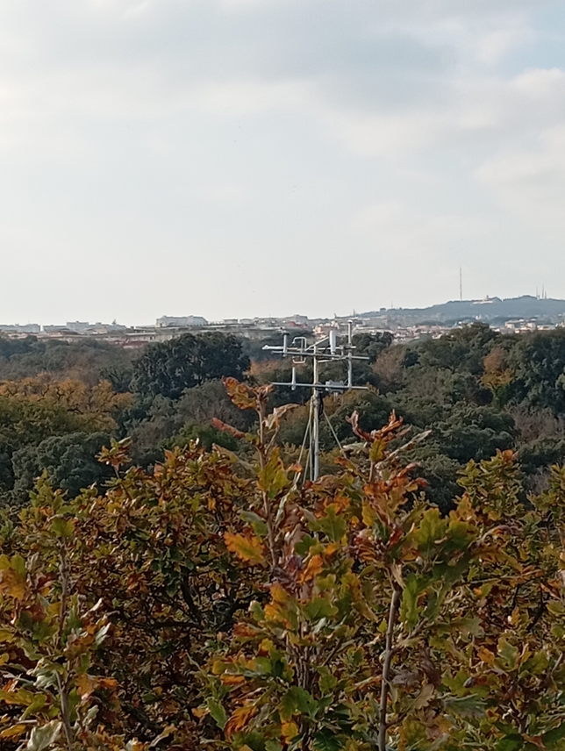
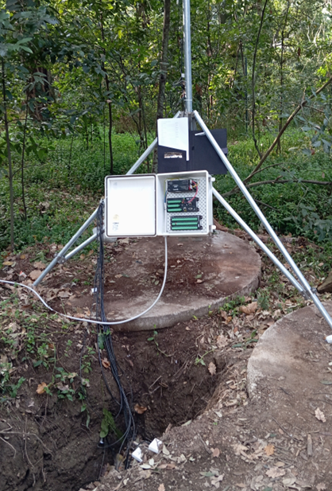
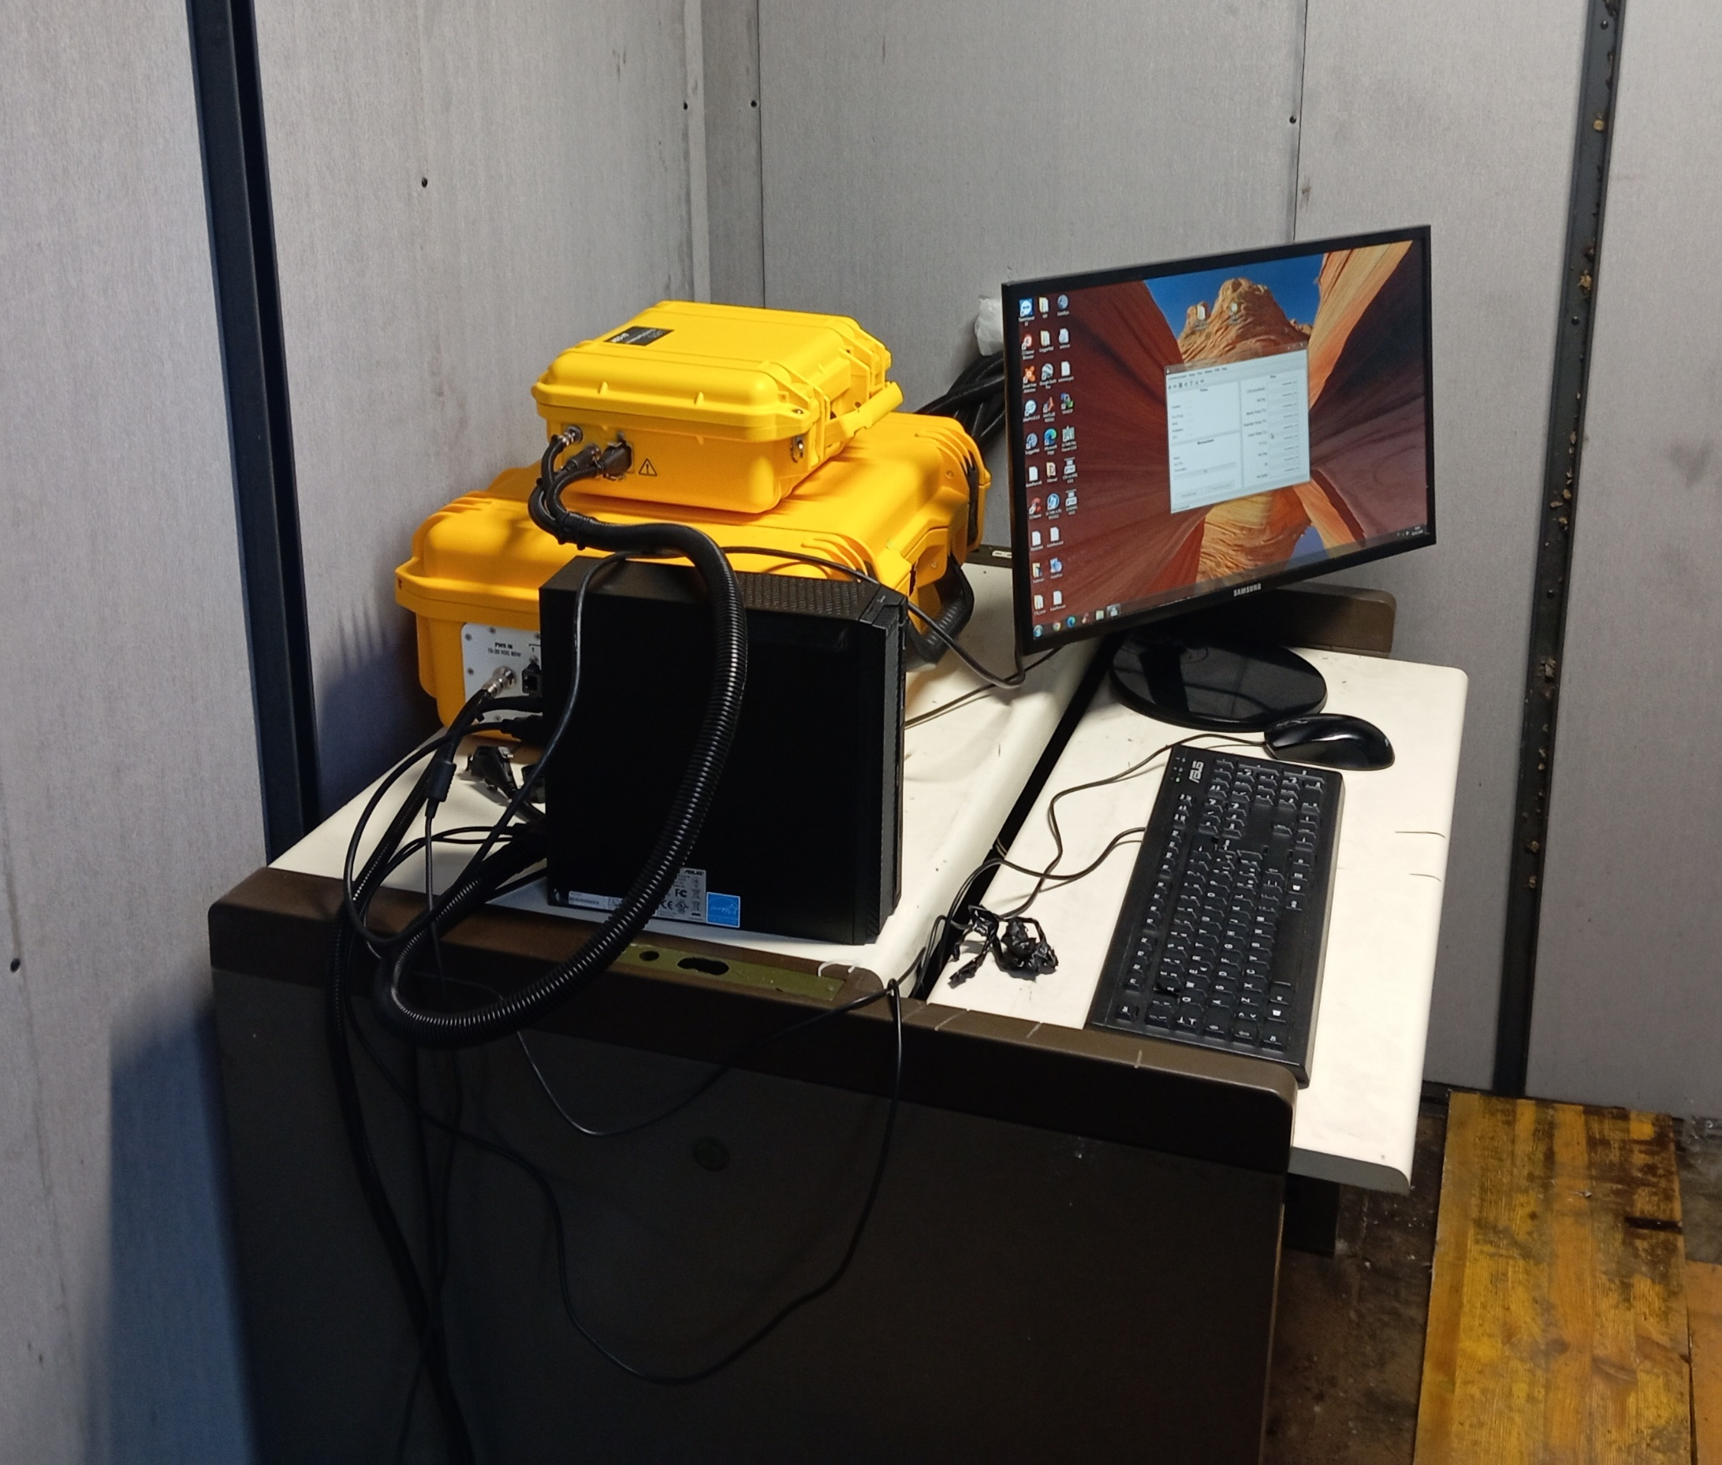
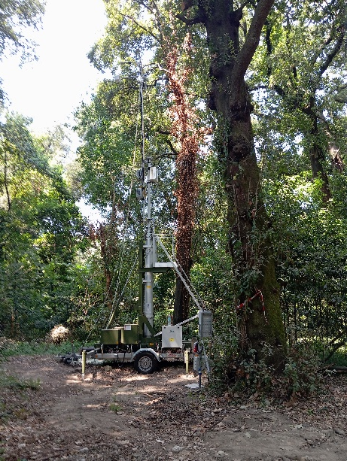
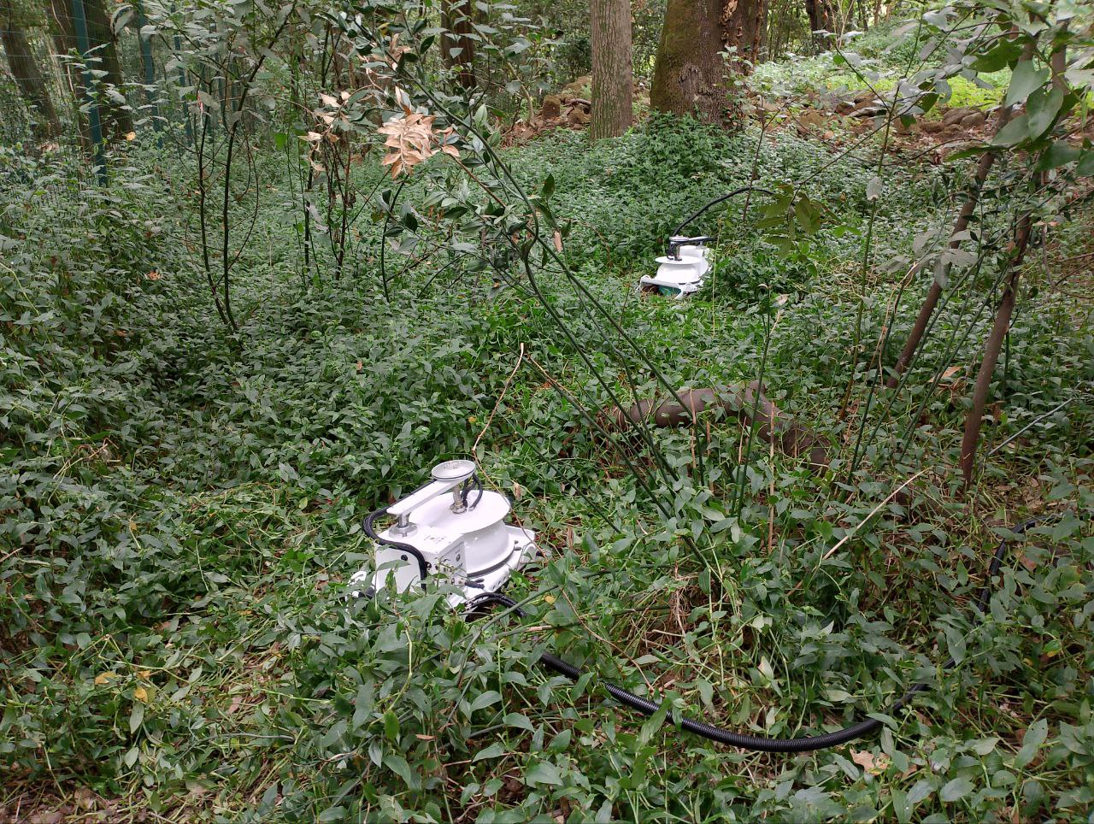
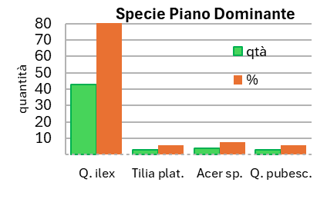
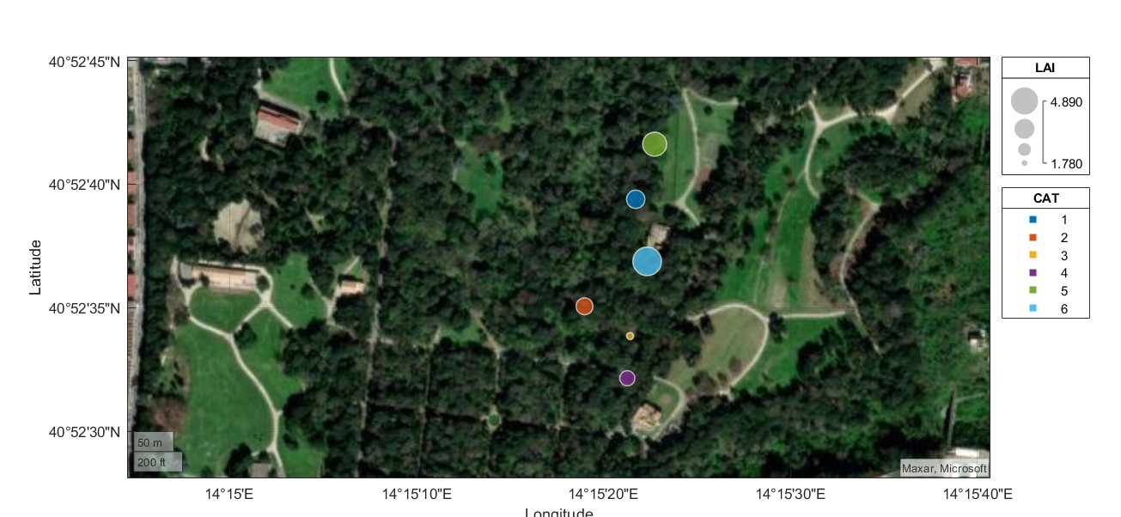
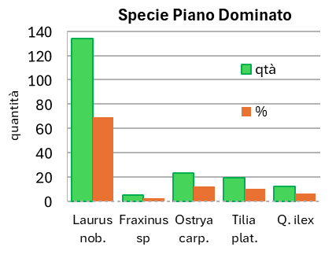
CNR IRET Conference
Rome, February 18th-19th 2025
The ICOS ecosystem site of Real Bosco di Capodimonte
Teresa Bertolini. T. Zenone, C.Corradi, G. Guidolotti, M. Mattioni, M.Micali, L.Sessa, D. Piastrelloni, A.Di Palma, I.Tunno, A scartazza, E. Pallozzi, and C. Calfapietra
.
The CO₂ and H₂0 exchange are monitored with an eddy covariance system.
Soil environmental conditions and CO₂ fluxes are monitored continuously
Aerial view of the park: commissioned by King Charles Borbone in 1734 to the architect Ferdinando Sanfelice as a hunting reserve around the Reggia Borbonica, now the Museum of Capodimonte. For its botanical (400 botanical species) and architectural heritage, is one of the most important park in Italy.
This research is made possible by the ICOS network and the National Biodiversity Future Center - NBFC. We would like to acknowledge the Soprintendenza of Real Bosco di Capodimonte in particular the former director Dr Sylvain Bellenger, and the new director Dr Eike Schmidt.
The site is located within the city of Naples and cover an area of about134; the main species that characterized the park are Quercus ilex L., which occupies about 80 % of upper canopy layer with a height average of 22 m. The underneath layer is characterized by the presence of Laurus nobilis and other Mediterranean species
The temporal dynamics of LAI is monitored throughout the year within the footprint of the eddy covariance tower
Teresa Bertolini

