Slide 1


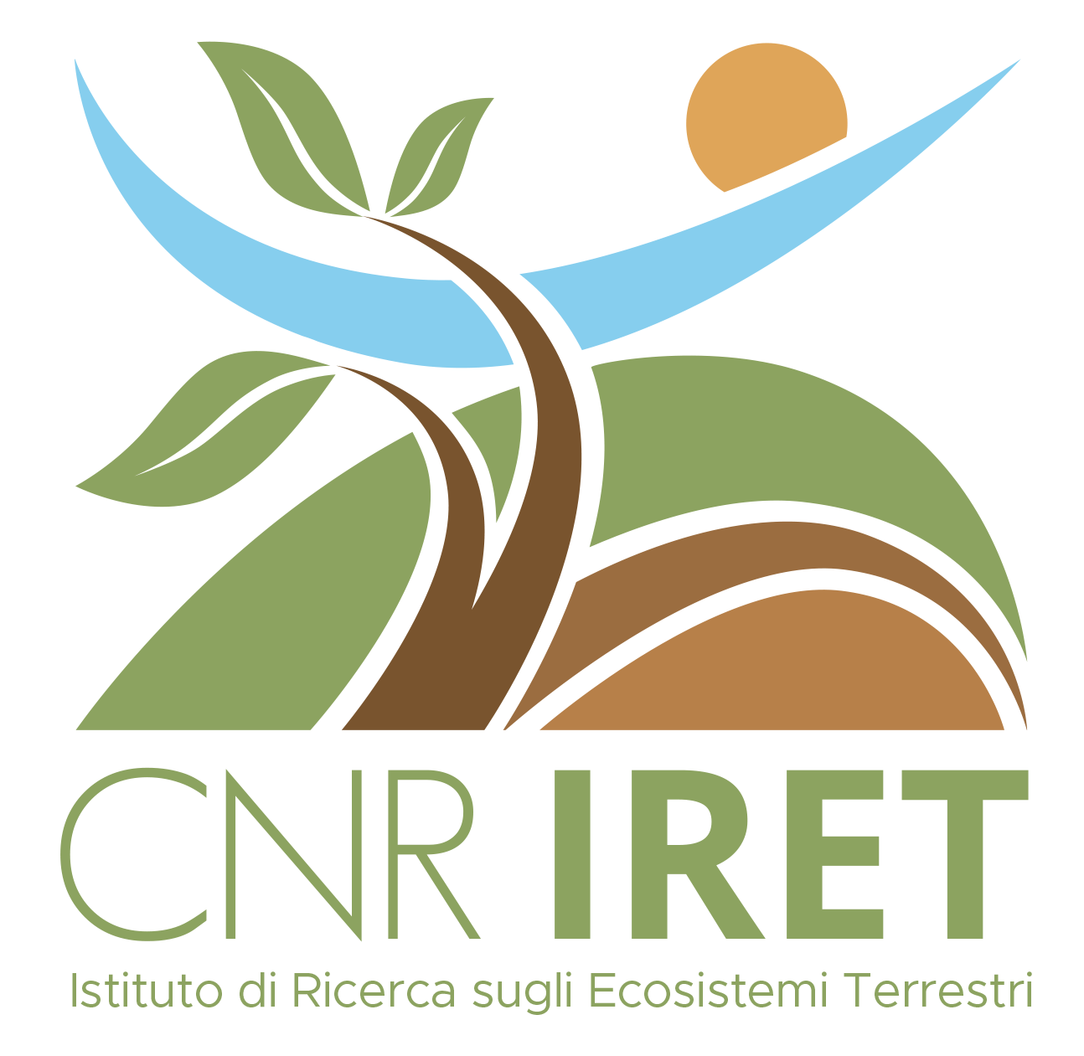
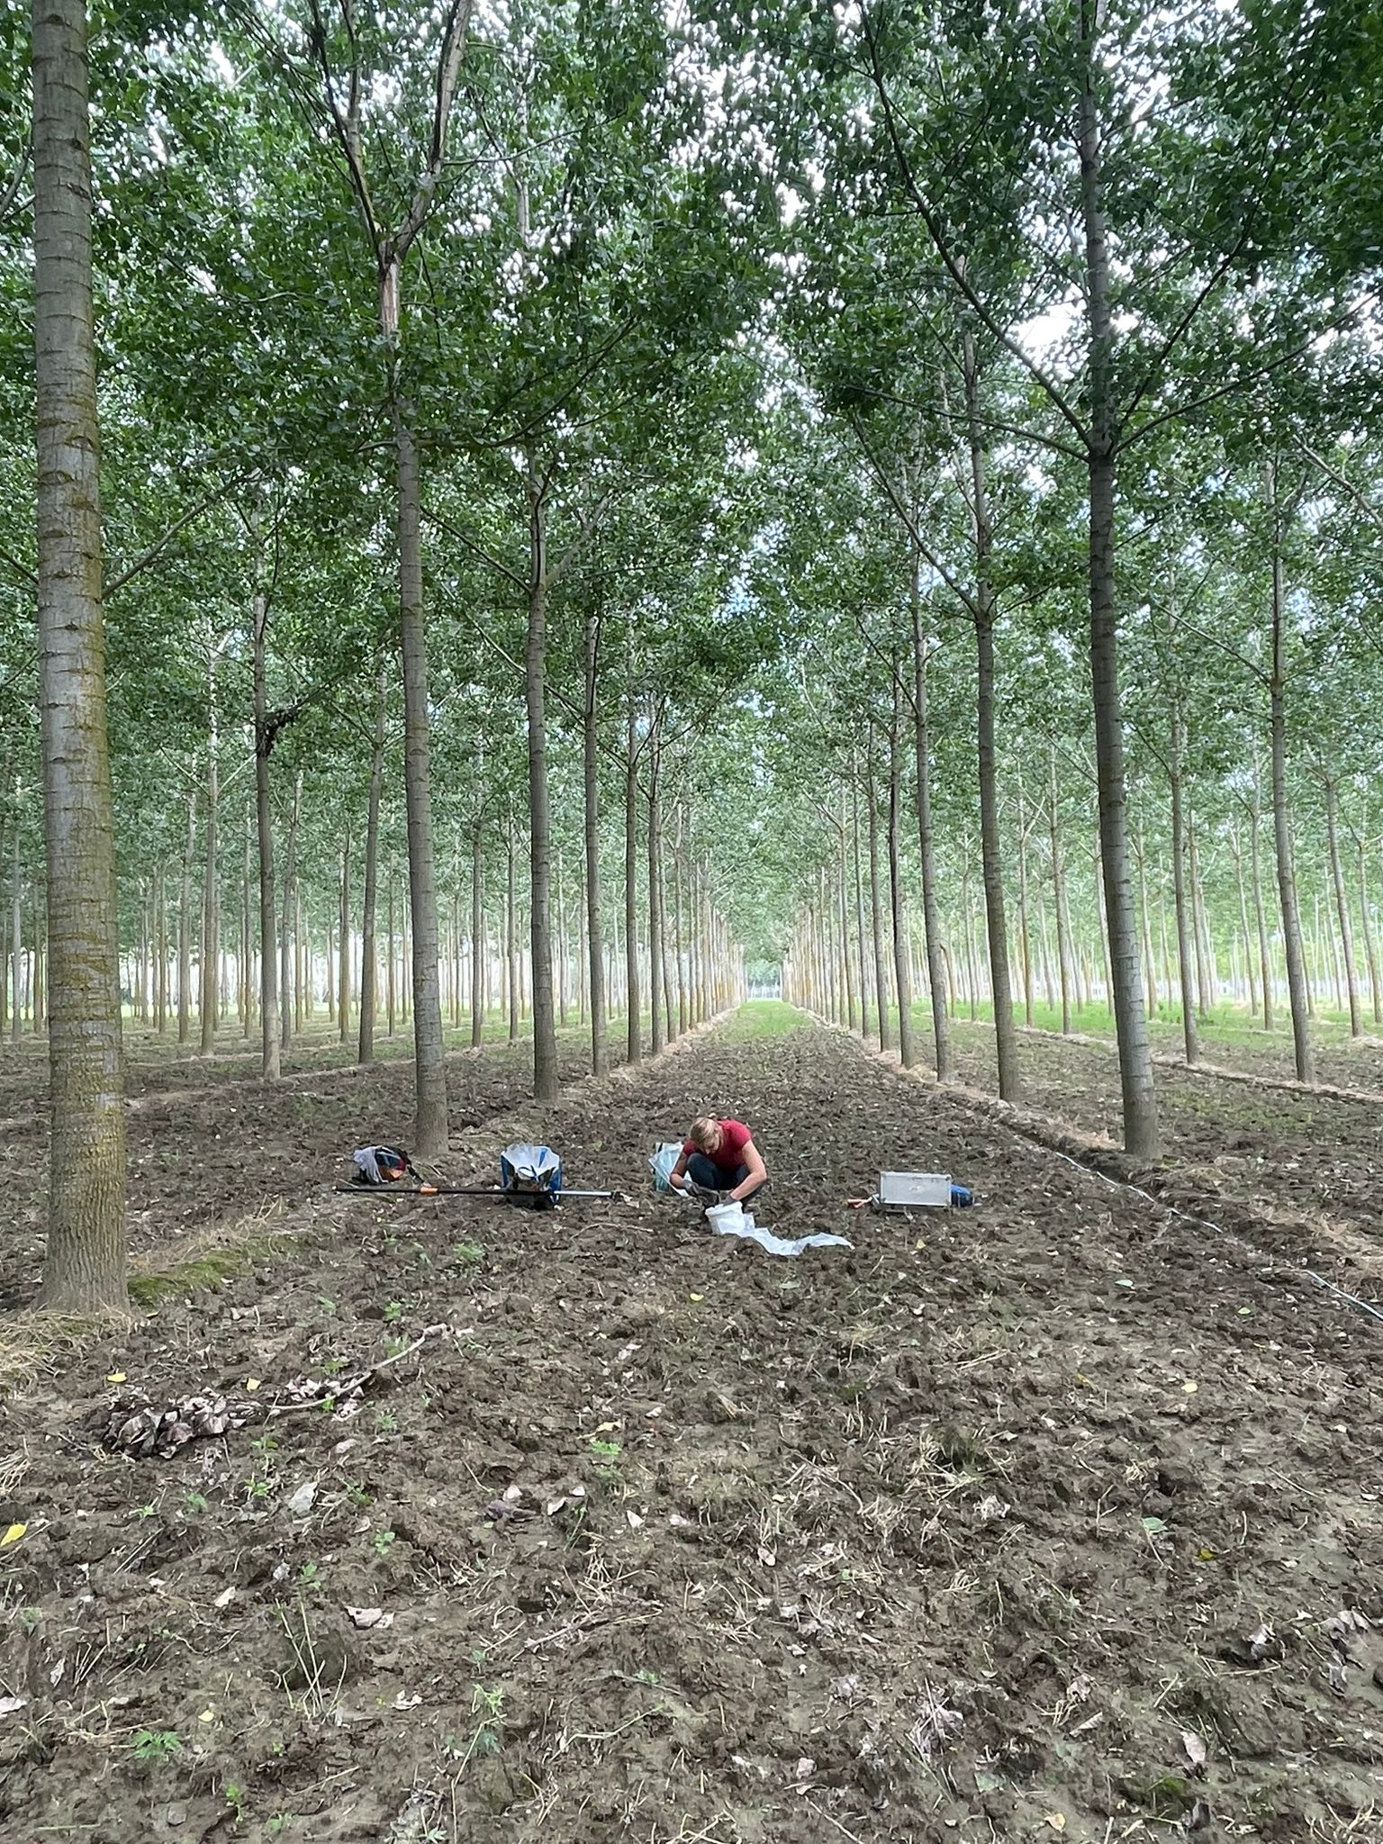
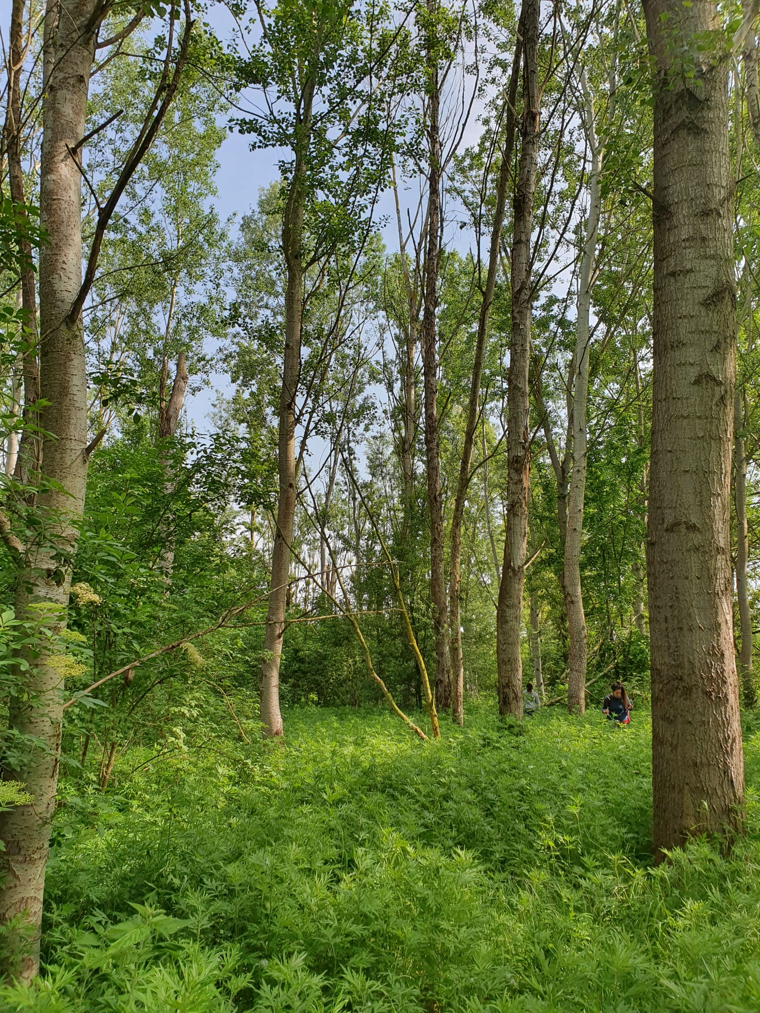
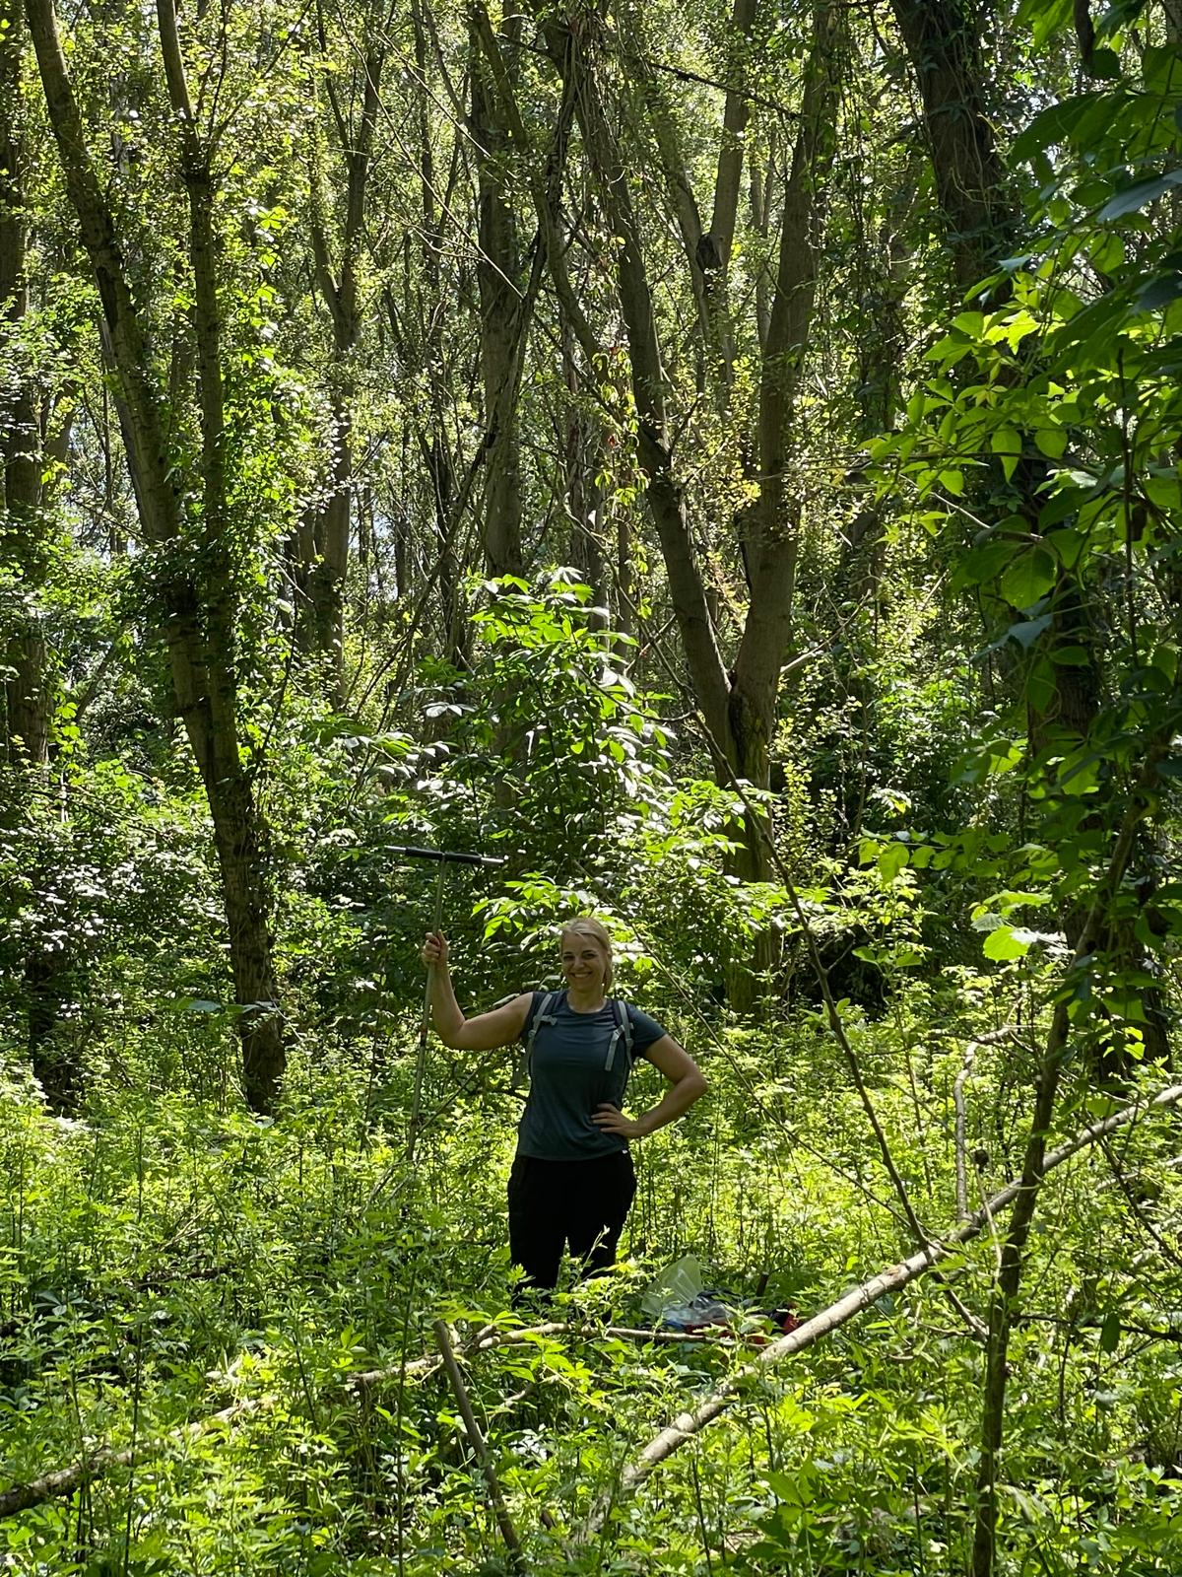
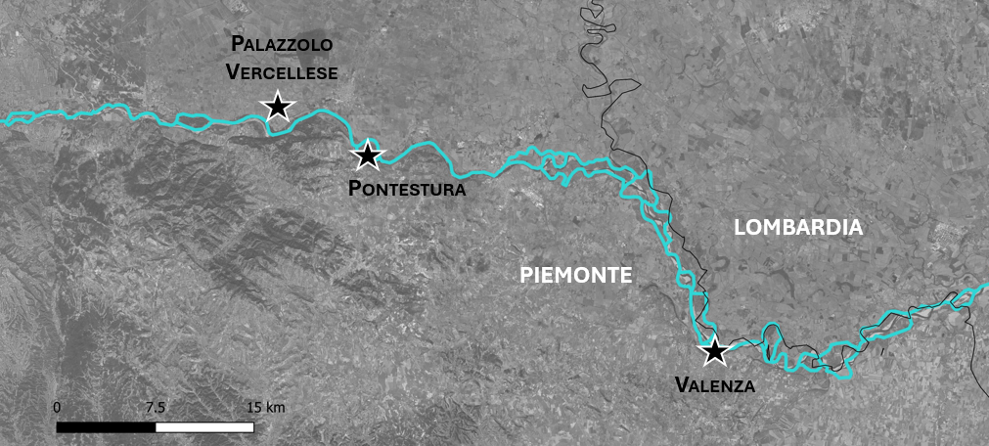
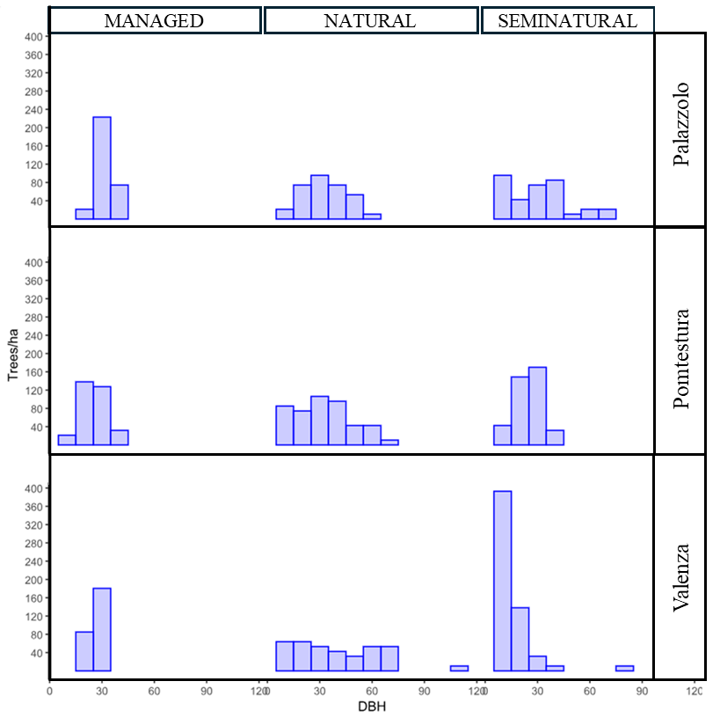
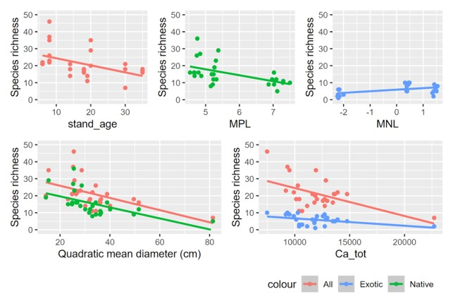
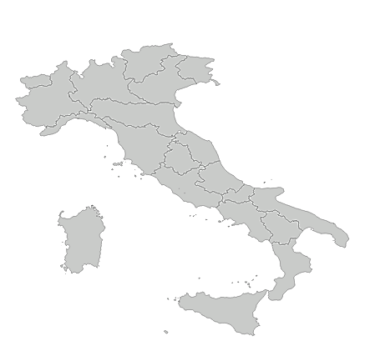
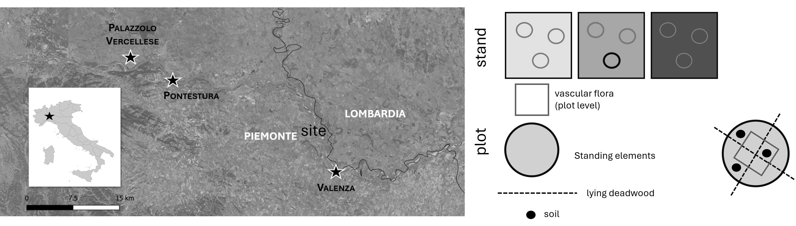
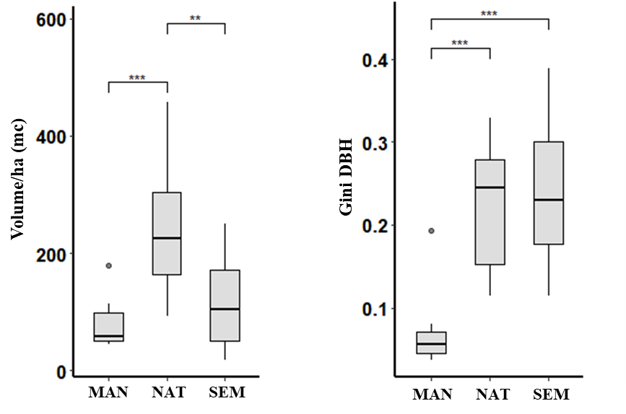
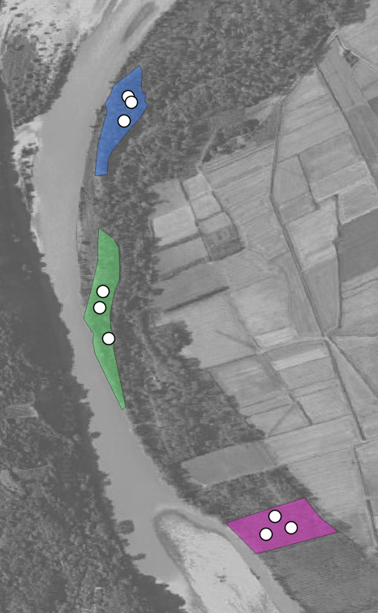
CNR IRET Conference
Rome, February 18th-19th 2025
Determinants of vascular species diversity on poplar natural and semi-natural woodlands: a stand scale approach
Giovanni Trentanovi^{1*}, Anna Corli^{2,3}, Francesca Vannucchi^{1,3}, Silvia Traversari^{1,3}, Simone Orsenigo^{2,3}, Pier Mario Chiarabaglio⁴, Francesco Chianucci⁴, Carlo Calfapietra^{1,3}, Andrea Scartazza^{1,3}, Maria Laura Traversi¹, Luca Cristaldi⁵, Alessio Giovannelli^{1,3}
¹ Istituto di Ricerca sugli Ecosistemi Terrestri – Consiglio nazionale delle Ricerche (IRET-CNR); ² Dipartimento di Scienze della Terra e dell'Ambiente, UNIPV; ³ NBFC, National Biodiversity Future Center; ⁴ CREA - Centro di ricerca Foreste e Legno; ⁵ Ente di gestione delle Aree Protette del Po piemontese.
managed
seminatural
natural
Management gradient
Study area and sampling design
Woodland stand structure characterization
Determinants of vascular flora diversity
Number of trees/ha
Species richness
Species richness
Species richness
STAND
DBH (cm)
natural
Stand age (years)
Mic. phosph. limitation
Mic. Nitrog. limitation
P
L
O
T
seminatural
Species richness
Species richness
managed
Quadratic mean diameter (cm)
Total Ca (mg kg⁻¹)
Improving the functionality of the river environment through new plantations is a powerful NBS. Our work tested the effectiveness of a novel and replicable methodological approach that allows the assessment of the ecology and functionality of riverine poplar stands with different gradients of naturalness. Results will allow the selection of river ecosystem management strategies that meets the requirements of Nature Restoration Law (Regulation EU 2024/1991).

