Slide 1


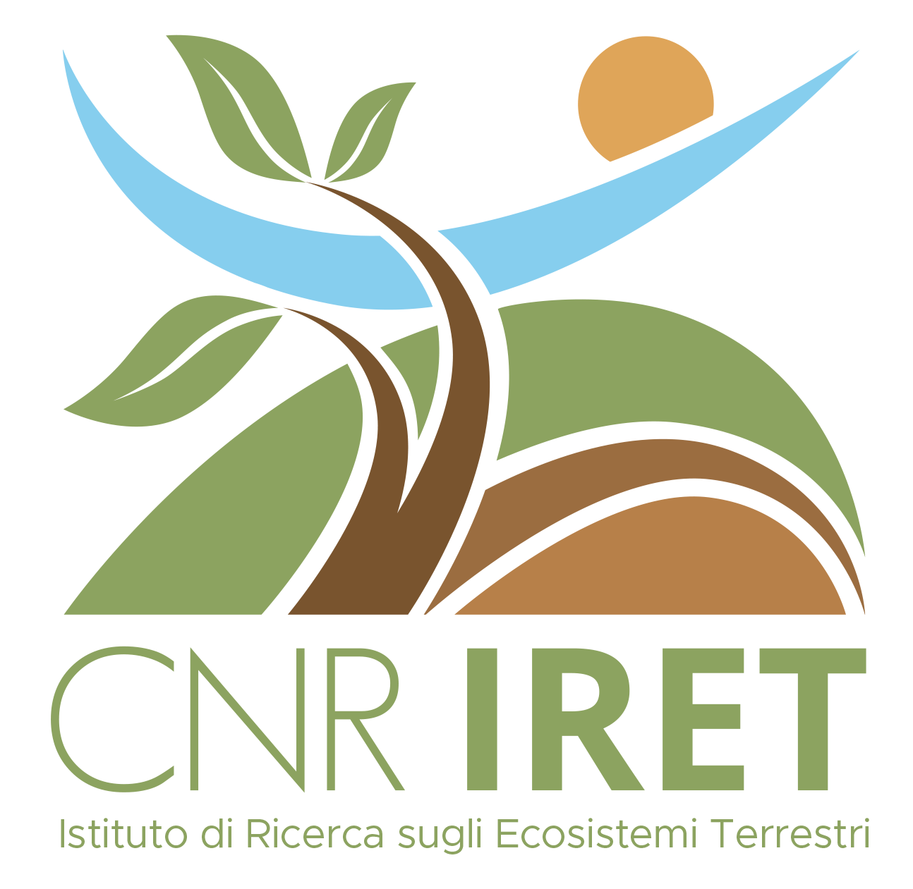
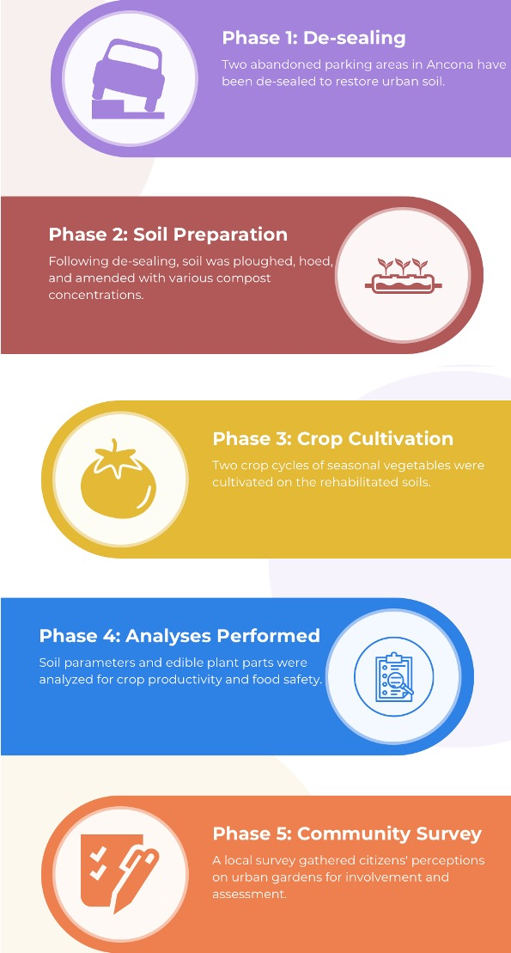
CNR IRET Conference
Rome, February 18th-19th 2025
Revitalizing urban landscapes by desealing: the REUSES project for soil restoration and sustainable community development
S. Di Lonardo^{1,2}, N. Pampuro³, G. Giacomello^{1,3}, A. Salvucci⁴, D. Serrani⁴, L.P. D’Acqui¹, S. Cocco⁴, V. Cardelli⁴
¹Research Institute on Terrestrial Ecosystems (IRET), National Research Council of Italy (CNR), Via Madonna del Piano 10, 50019 Sesto Fiorentino, Italy; ²National Biodiversity Future Center (NBFC), Piazza Marina 61, 90133 Palermo, Italy; ³Institute of Sciences and Technologies for Sustainable Energy and Mobility (STEMS), National Research Council of Italy (CNR), Strada delle Cacce 73, 10135 Torino, Italy; ⁴Department of Agricultural, Food and Environmental Sciences, Polytechnic University of Marche (UNIVPM), Via Brecce Bianche 10, 60131 Ancona, Italy
Sara Di Lonardo

