Slide 1




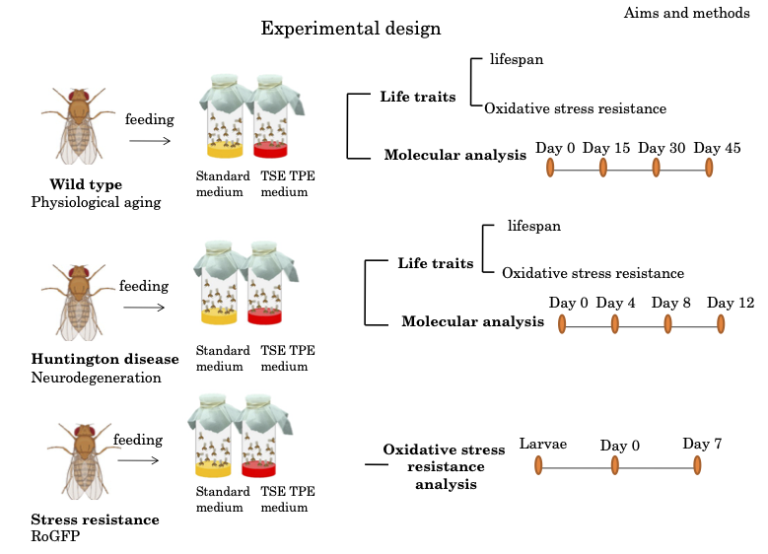
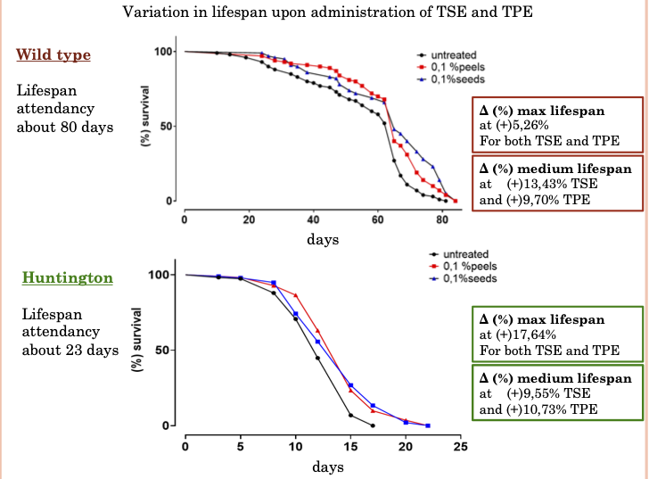

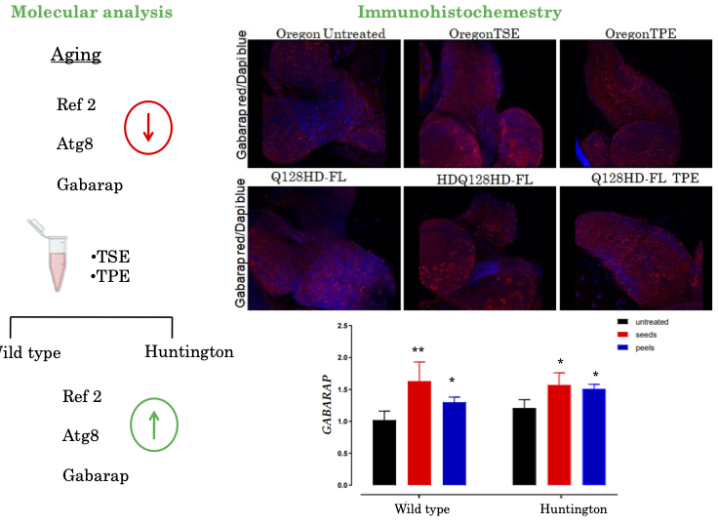
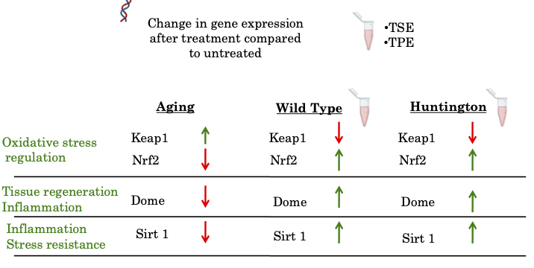
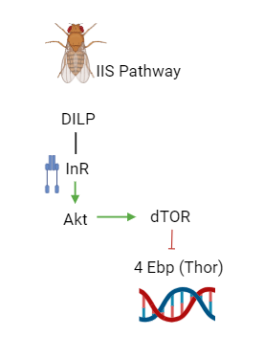




CNR IRET Conference
Rome, February 18th-19th 2025
Effects of the Byproduct of tomato processing on Aging in Drosophila melanogaster
Maria Rosaria Carillo^{1,2}, Filomena Anna Digilio^{1,3}
¹ Research Institute on Terrestrial Ecosystems (IRET)-CNR, Via Pietro Castellino 111, 80131 Naples, Italy; ² ISPA CNR, largo Paolo Braccini 2
10095 Grugliasco (TO) ³ National Biodiversity Future Center (NBFC), 90133 Palermo
The aim of this work is the study of aging utilizing products derived from tomato-industrial waste in the model organism Drosophila melanogaster
Growing interest in sustainable and natural solutions
Experimental design
Lifespan
Reducing oxidative
stress.
Potential effects
on preventing
age-related
diseases
Combatting
free radicals
Bioactive
compounds
Polyphenols
flavonoids
Study Models
Efficacy tested on cellular and animal models
Molecular analysis
Autophagy regulation
Aging related pathways
Insuline pathway regulation (IIS)
WT
HD
F.Anna Digilio

