Slide 1


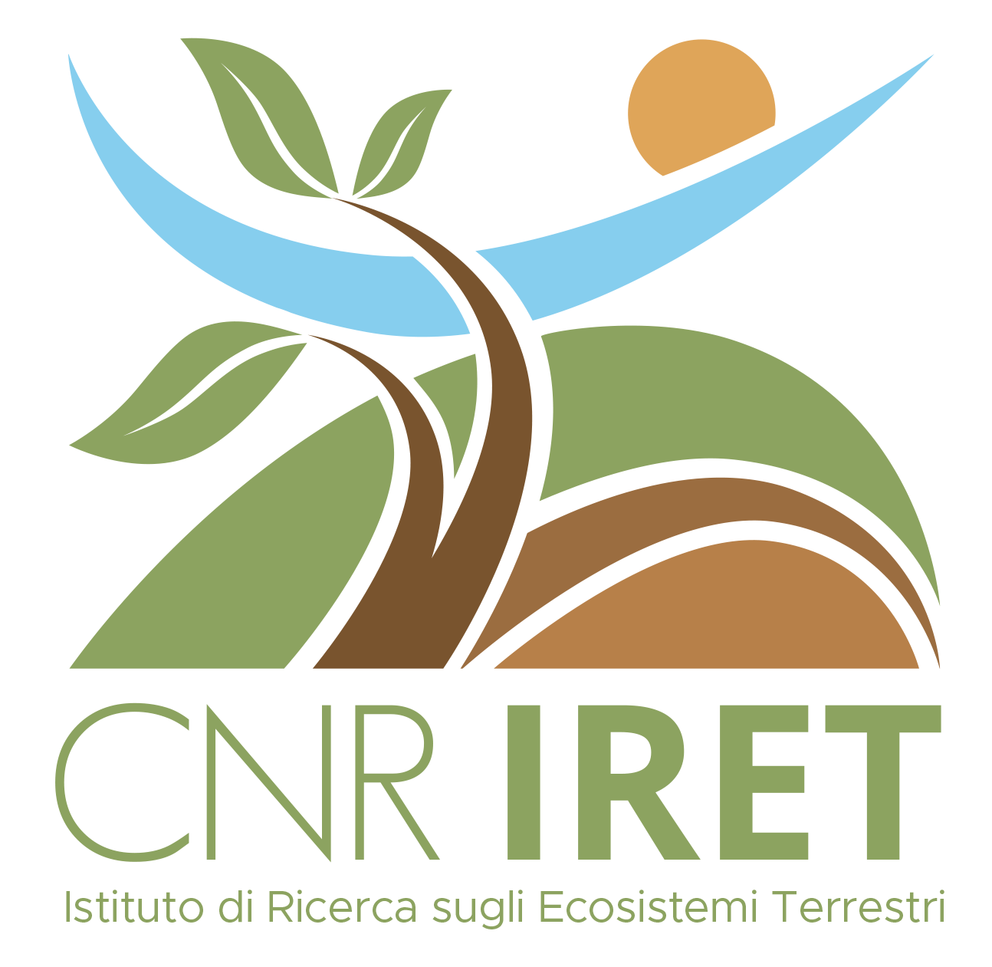
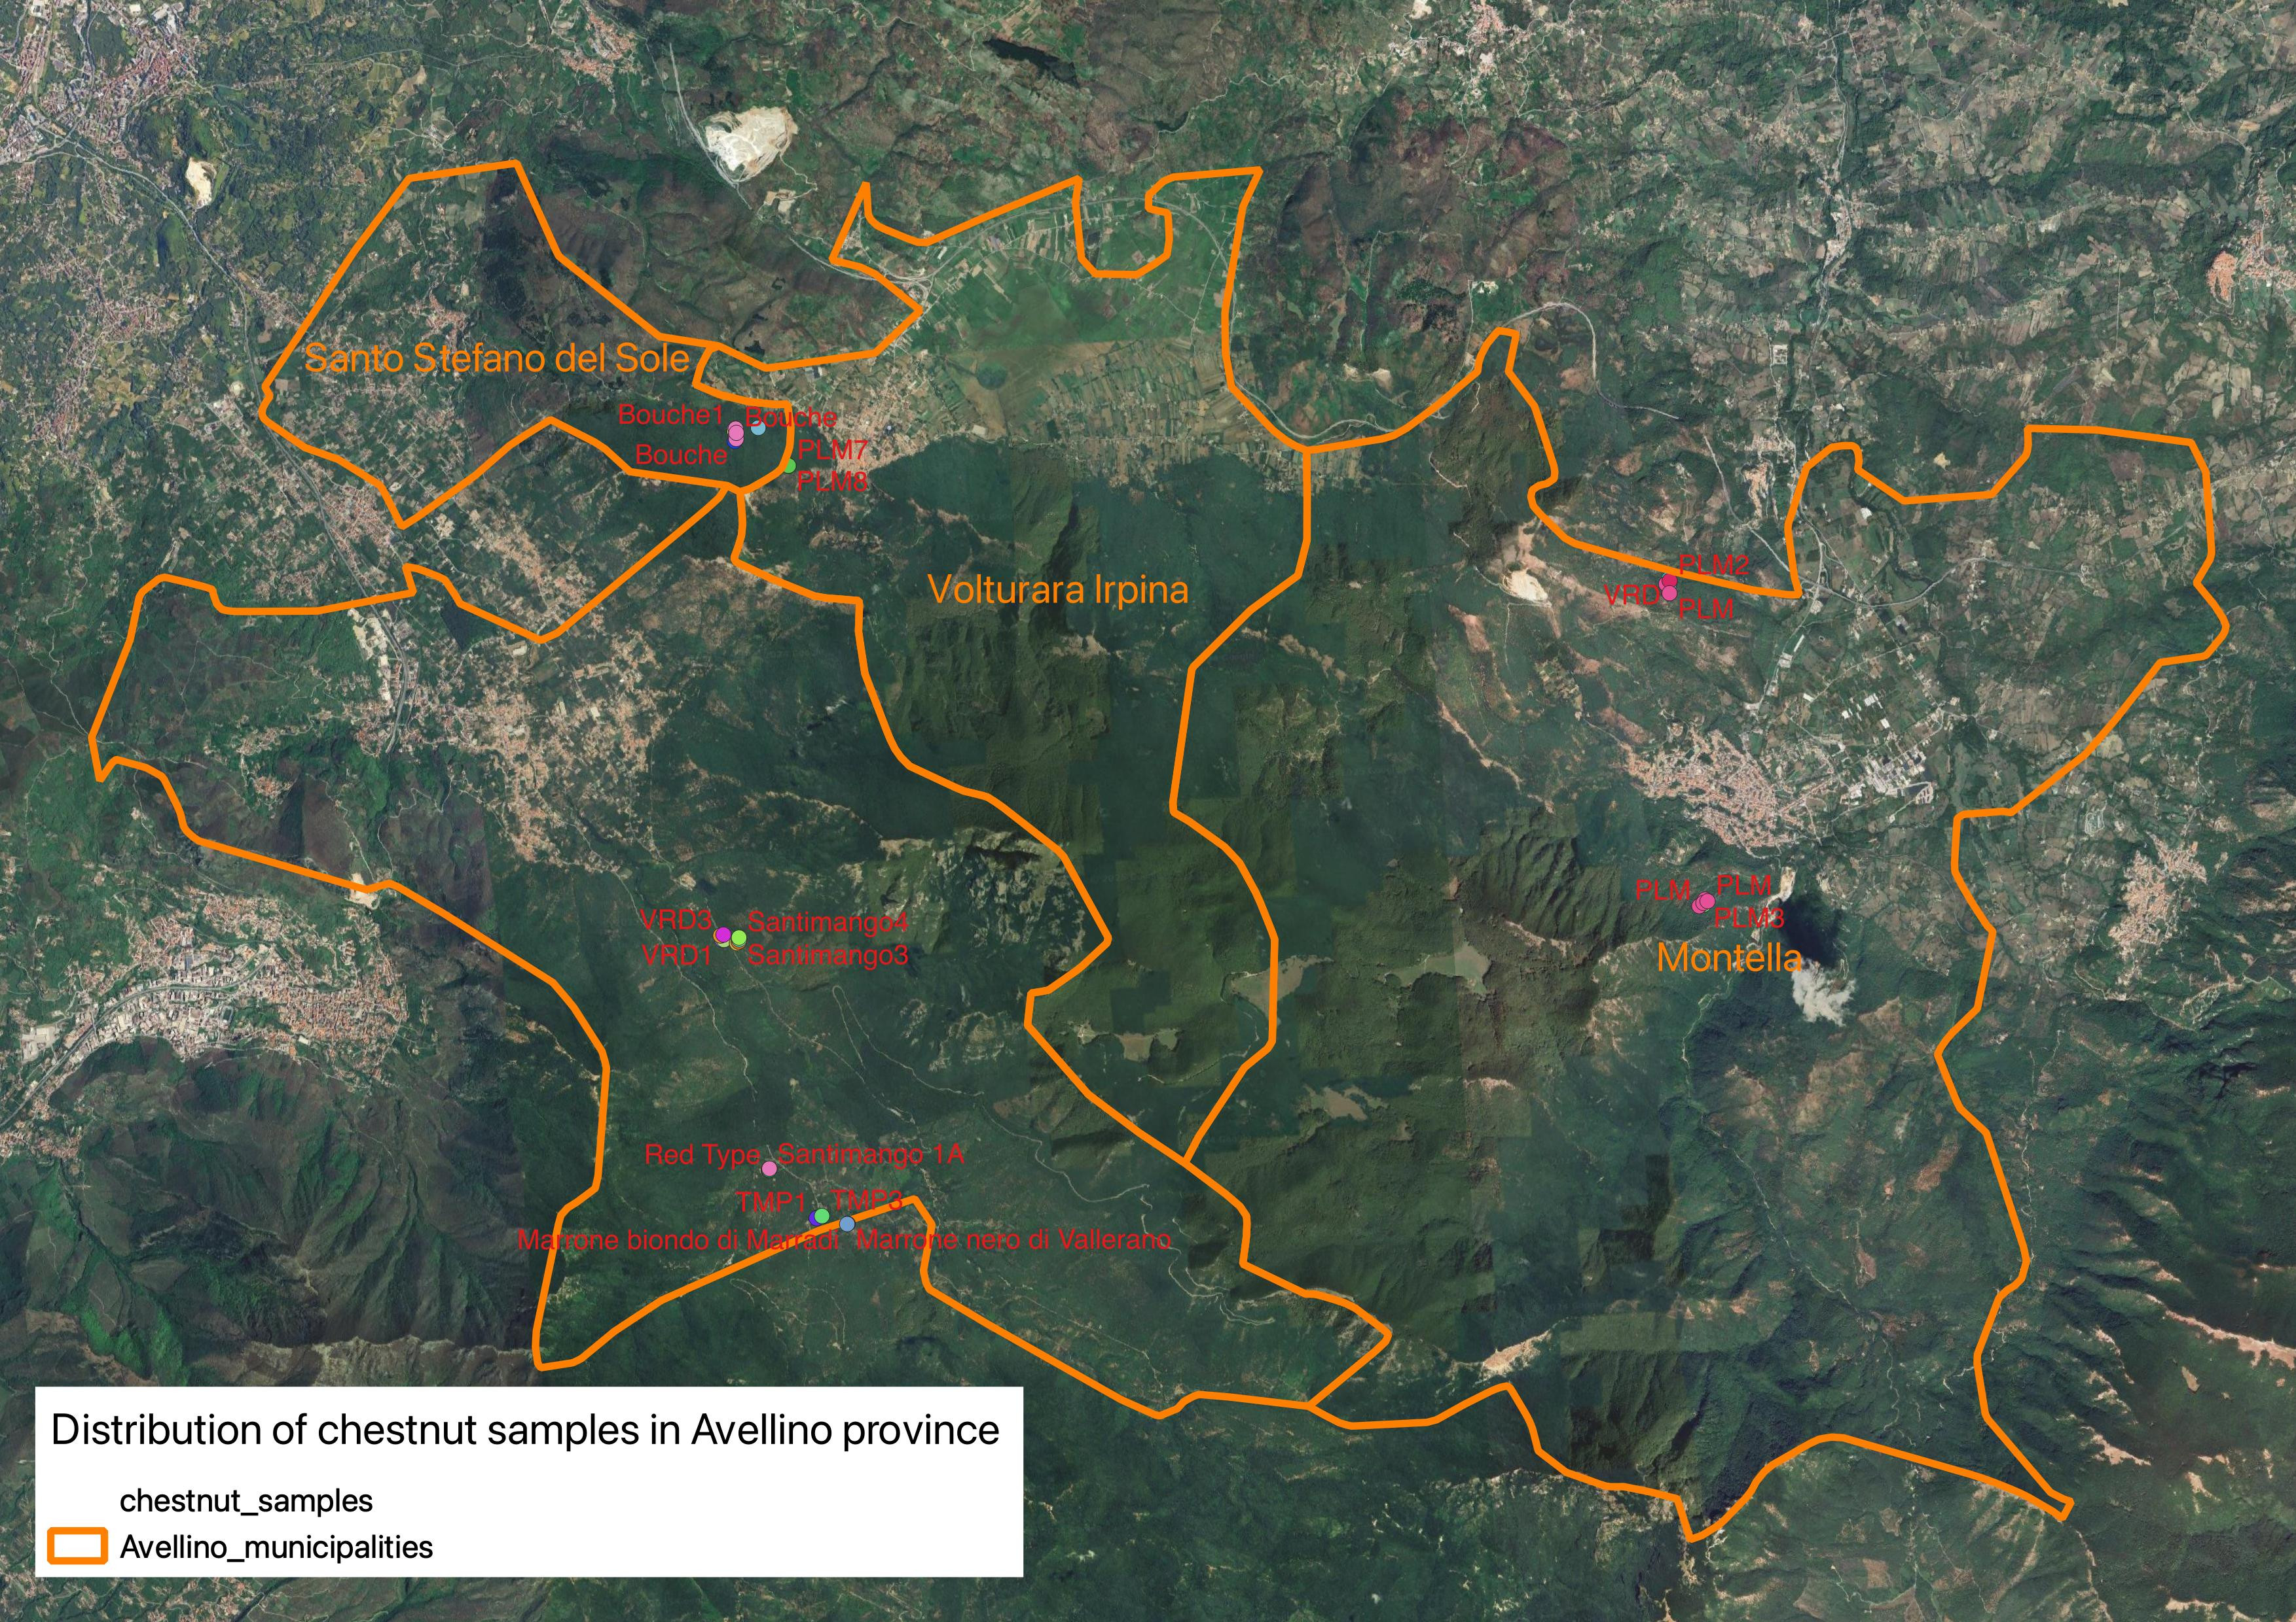

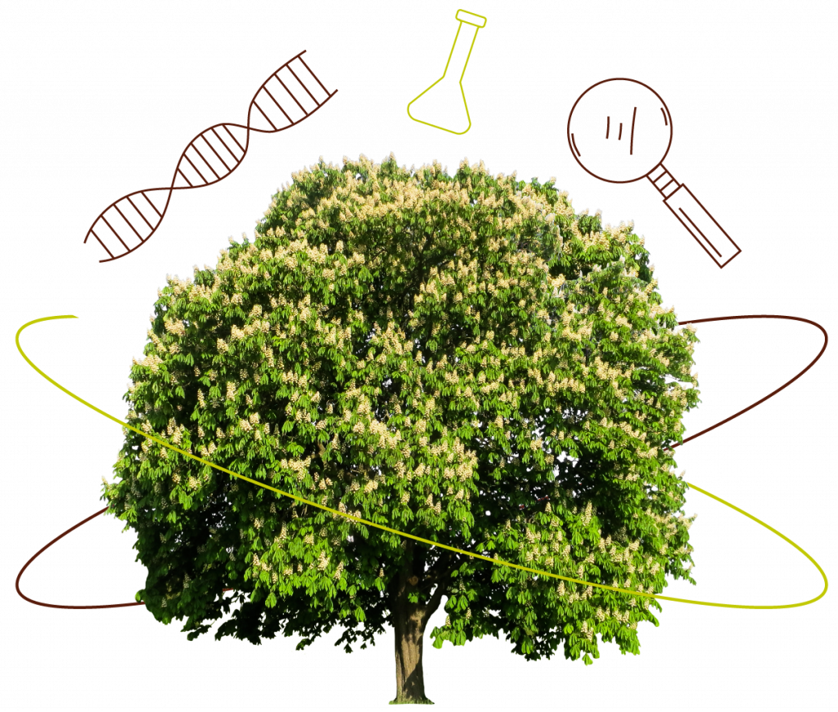
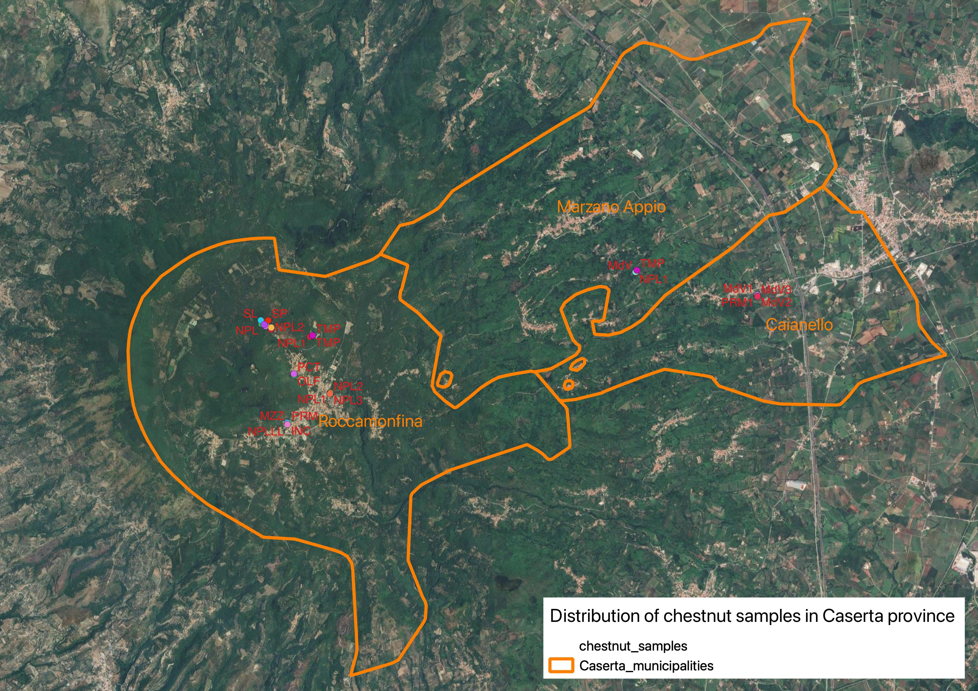



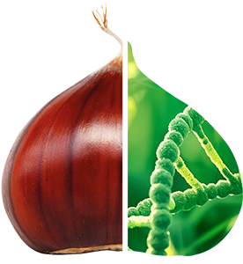


CNR IRET Conference
Rome, February 18th-19th 2025
The KasTrack project: chestnut biodiversity and distribution in Campania
M.M. Calandrelli¹, L. De Masi²
¹CNR – Research Institute on Terrestrial Ecosystems, Via P. Castellino 111, 80131 Naples, Italy
²CNR – Institute of Biosciences and Bioresources, Via Università, 133 - 80055 Portici (NA), Italy
Email: marinamaura.calandrelli@cnr.it
BACKGROUND AND AIMS
Varietal recognition is a key factor for rational management of sweet chestnut horchards (Castanea sativa Mill.). Since the morphological characteristics have some limitations and can be misleading, the main goal of technology transfer project KasTrack is to provide chestnut growers with an innovative system for genetic identification. After creating a genetic-spatial mapping, suitable protocols and bioinformatics tools will be released to the control laboratories interested in providing the service of varietal identification.
PROJECT IMPACT
Nursery Sector Development
Varietal Heritage Conservation
Product Traceability
Varietal Diversification
CONCLUSIONS AND PERSPECTIVES​
The KasTrack project will make the genotyping service accessible to potential users and will create a portal where information on the most widespread chestnut cultivars can be quickly found.
ACTIVITY AND EXPECTED RESULTS
Genetic-spatial mapping
Fingerprints database
Control laboratories with implemented service
Ex situ collection of genetic standards
Dissemination to stakeholders
https://kastrack.crea.gov.it
Marina Maura Calandrelli

