Slide 1





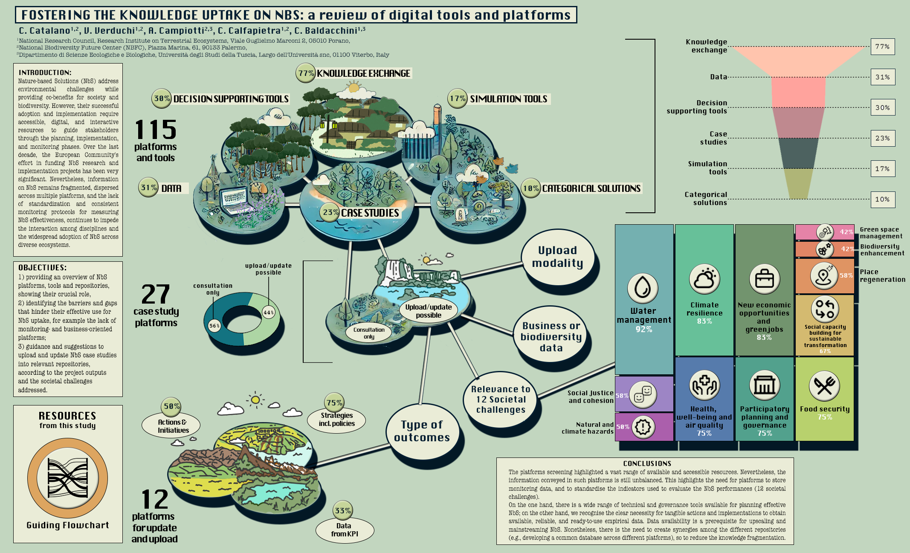
CNR IRET Conference
Rome, February 18th-19th 2025
Valentina
Verduchi

