Slide 1
Pervasive Intelligence for Smart Mobility (PRISMA )

Slide 2
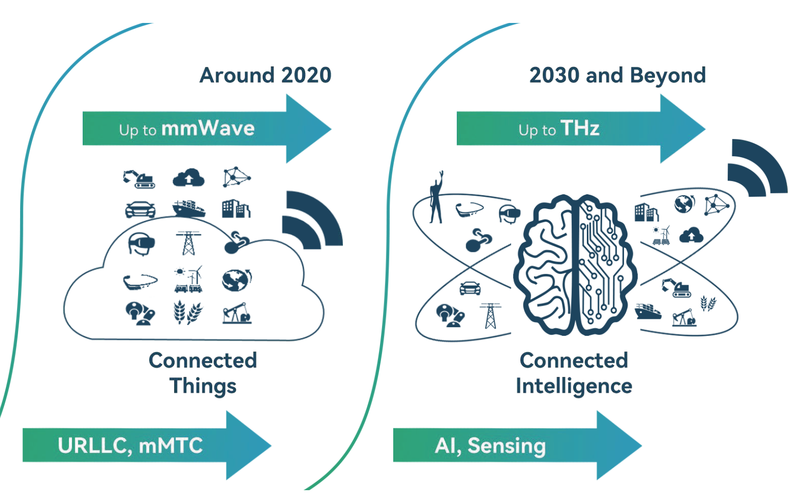
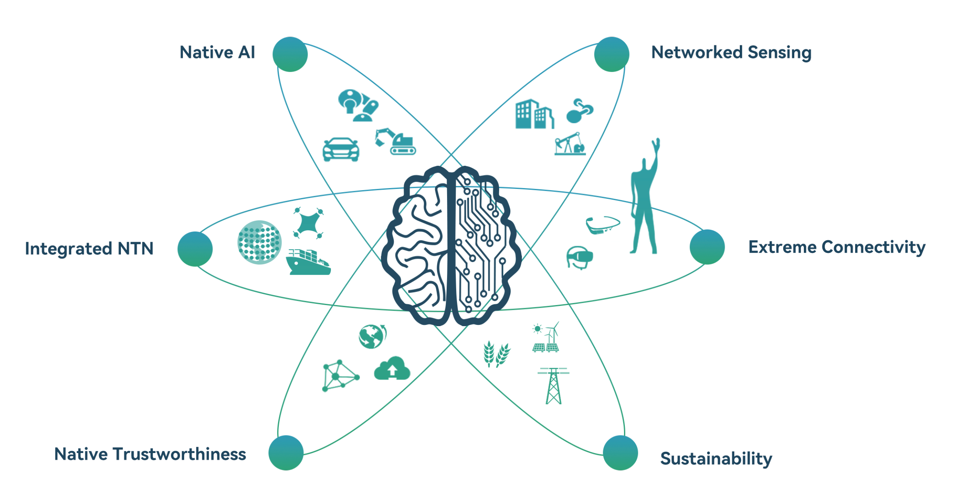
Future Internet: Pervasive connected intelligence
comp
comms
cross
Source: The Next Horizon White Paper, From Connected People and Things to Connected Intelligence, Huawei

Slide 3
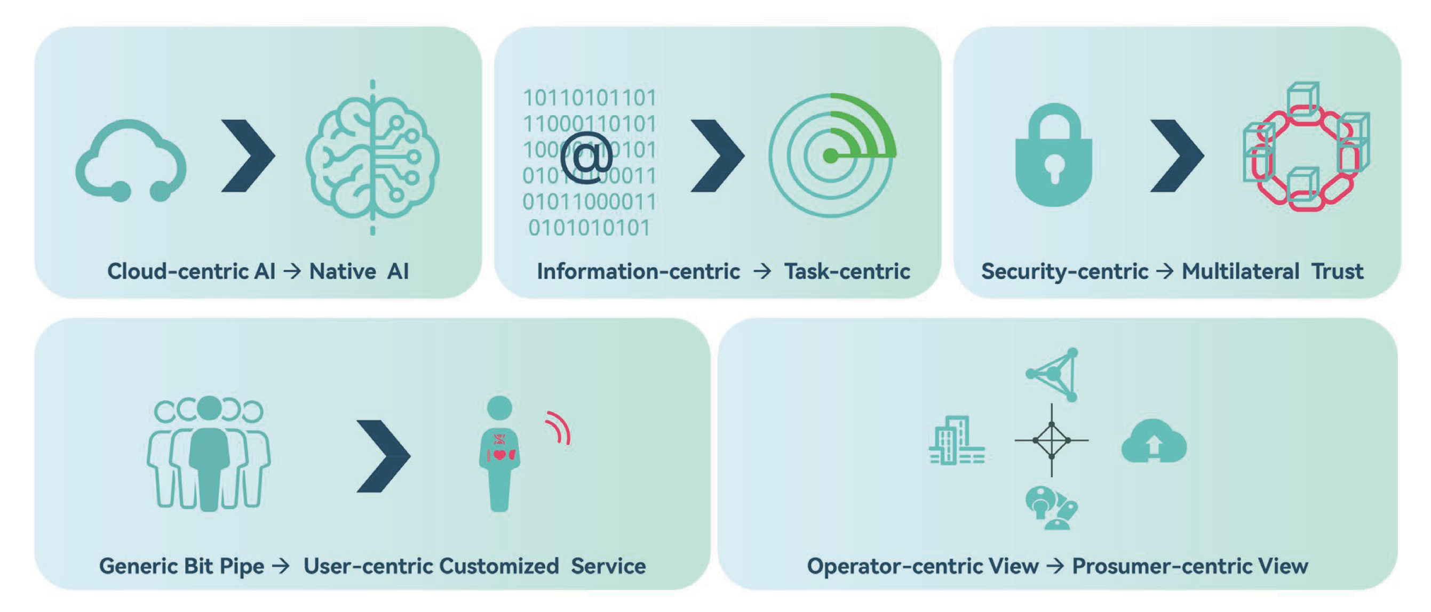
Paradigm shifts
Source: The Next Horizon White Paper, From Connected People and Things to Connected Intelligence, Huawei

Slide 4
PRISMA (Pervasive Intelligence for Smart Mobility)
Applications
Sustainable mobility
Foundations
Pervasive AI
Internet paradigms
Cybersecurity
Infrastructure services
(data, AI & networks)
AD prevalente: PE6

Slide 5
Critical mass
SoBigData
Data, AI & networks Research Spaces
FAIR
Affiliato Spoke 1, Affiliato Spoke 3, Affiliato Spoke 5, Affiliato Spoke 8, Affiliato Spoke 9
RESTART
Spoke 1, Affiliato Spoke 4, Affiliato Spoke 5
SERICS
Affiliato Spoke 3, Affiliato Spoke 4, Affiliato Spoke 5, Affiliato Spoke 7, Affiliato Spoke 8
MOST
Spoke 3, Affiliato Spoke 4, Affiliato Spoke 6, Affiliato Spoke 7

Slide 6
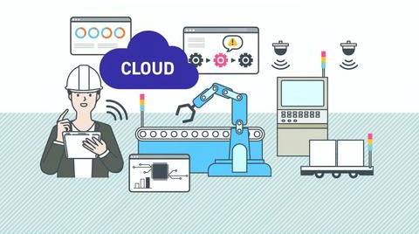
Collaboration network
Industry
Leonardo
Intesa Sanpaolo
Generali
Fincantieri
ST Microelectronics
Telecom Italia
Siemens
Thales
IBM
SKY
Ericsson
OpenFiber
Vodafone
WindTre
Almaviva
Academia
Sorbonne University
Eurecom
INRIA
UC3M
DFKI
Fraunhofer
TU Munich
PSNC
Barcelona Supercomputing Centre
ETH Zurich
KTH
Kings College London
Alan Turing Institute
Ferrovie dello Stato
Accenture
Stellantis
Hitachi
Ferrari
Leonardo
Unipol
Poste Italiane
Autostrade
Iveco
Coop
Unicredit
Monte dei Paschi di Siena
Fineco Bank
Orange
Bloomberg
~600 companies from Cascade Calls

